Slide 1
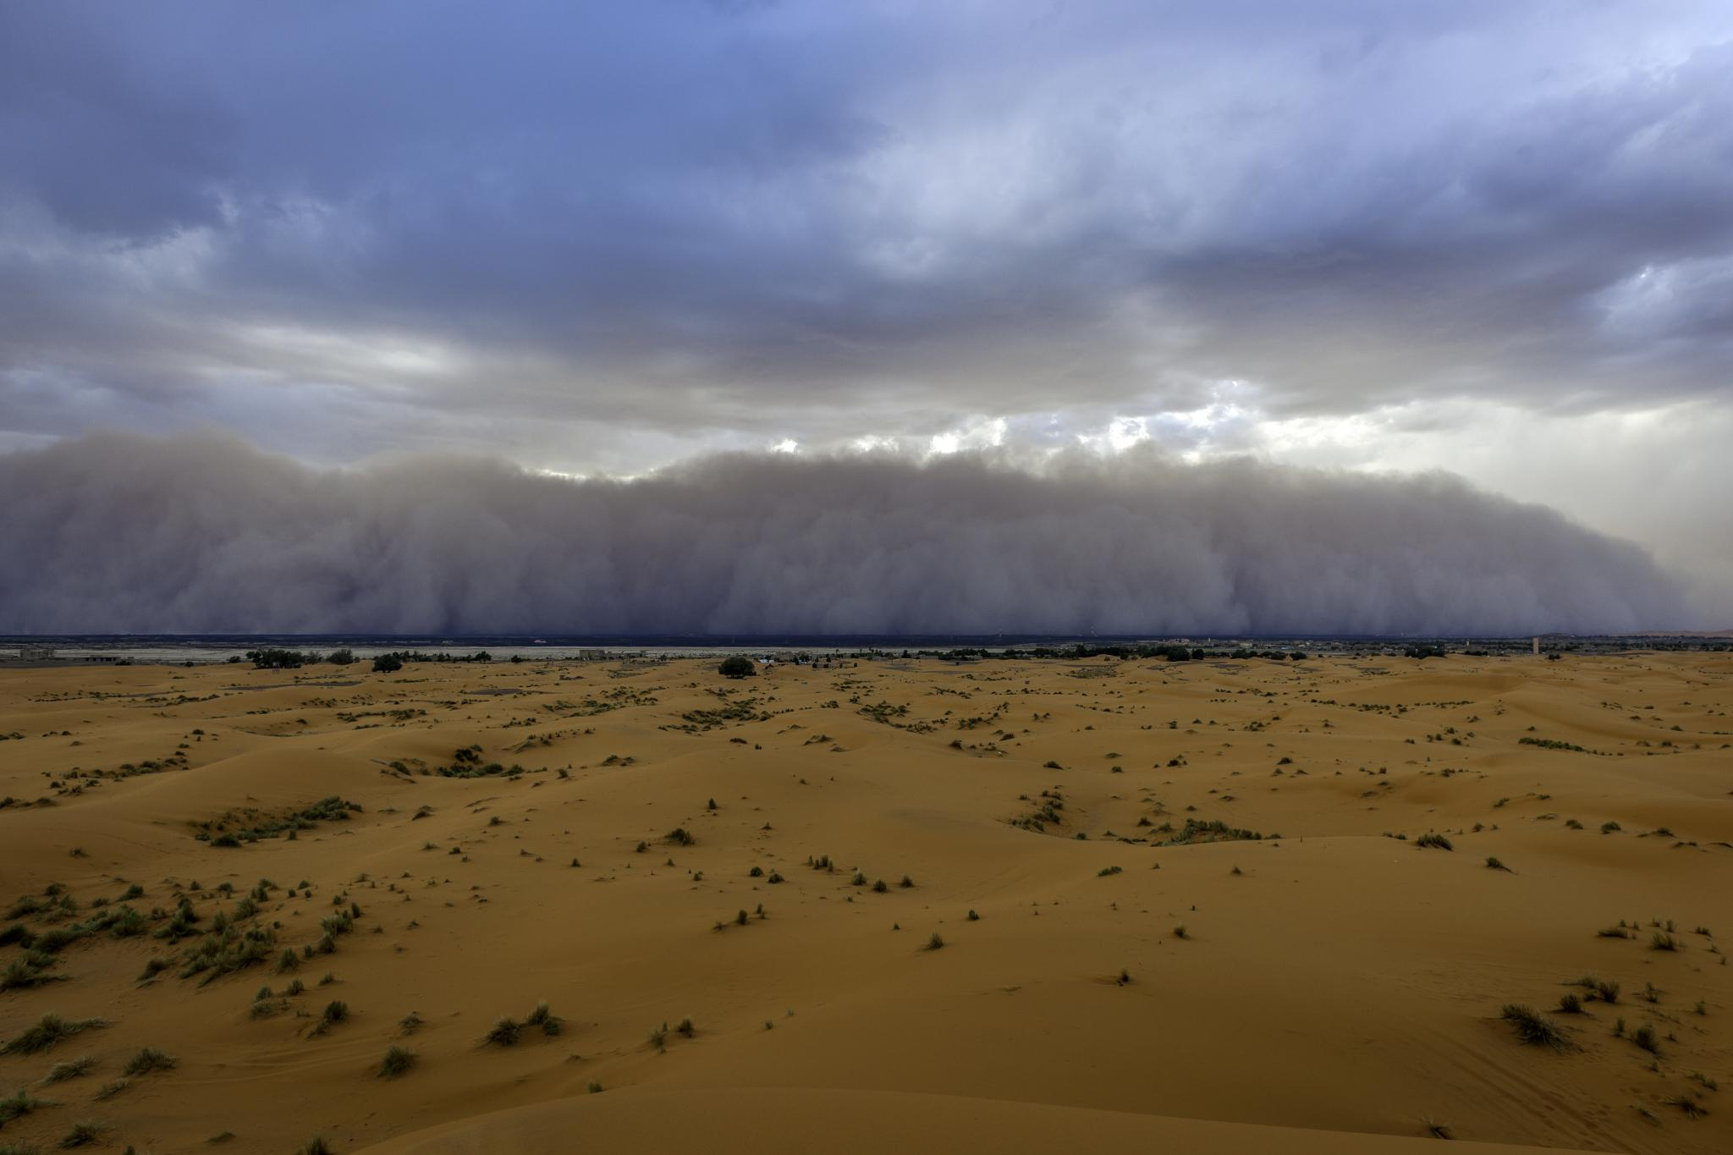
Monsoon Storms in the Desert Southwest

Slide 2

Overview of rainfall, storm activity, and impacts across AZ, NM, NV, SE CA, and UT-CO border
2025 Monsoon Season in the Desert Southwest

Slide 3

Introduction to Monsoon Storms
Seasonal Weather Pattern
The North American Monsoon (NAM) affects the Desert Southwest from mid-June through late September. The 2025 season saw a return to active monsoon conditions after a dry 2024.
Seasonal Atmospheric Shift
Monsoon storms result from seasonal shifts causing low-pressure zones that draw moist air inland. Moist air is drawn from the Gulf of California, Pacific Ocean, and Gulf of Mexico.
Climate Influence
El Niño delays monsoon onset and reduces storms; La Niña causes earlier onset and more rainfall.
Intense Storm Characteristics
These storms bring intense thunderstorms, heavy rainfall, and severe weather. Storms pose risks due to their intensity & unpredictability.
Importance of Awareness
Understanding monsoon storms is crucial for preparedness, grid reliability, and public safety.

Slide 4
Impacts on the Region
Impact Type | Description | Consequences
Flash Flooding | Sudden heavy rainfall overwhelms dry terrain | Road closures, soil erosion-weaken pole base
Dust Storms (Haboobs) | Strong winds lift dust into the air | Reduced visibility, insulation tracking-flashovers
Lightning and Wind | Thunderstorms produce frequent lightning and gusts | Infrastructure damage, wildfire ignition, arcing
Rainfall Contribution | Monsoon provides majority of annual precipitation | Water resource replenishment, ecosystem support

Slide 5
Historical Context (2016-2025)
2025 ranks among the top 4 wettest monsoons seasons of the decade.
Increased variability with fewer storm days but more intense events.
Comparison to 2024
2024: Below normal rainfall, weak storms.
2025: Much more active, with several major surges leading to near or above normal totals in AZ and NV

Slide 6
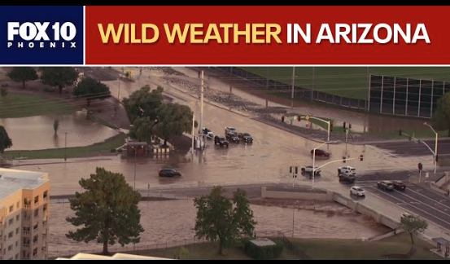
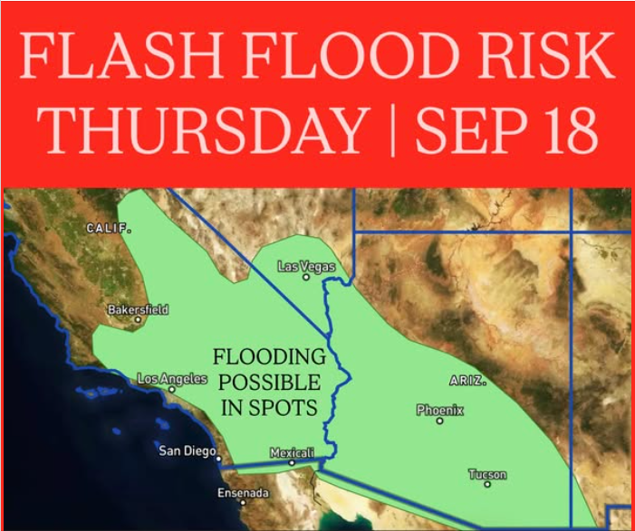
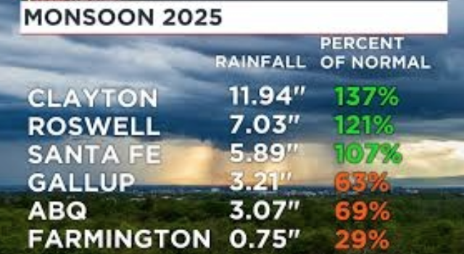
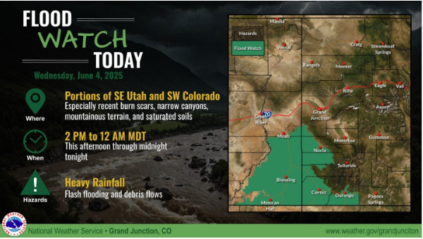
Regional Highlights
Arizona: Major floods in Phoenix
New Mexico: Mixed rainfall
Southern NV & SE CA: Flash floods in late September
Utah-CO border: Localized flooding and slides

Slide 7
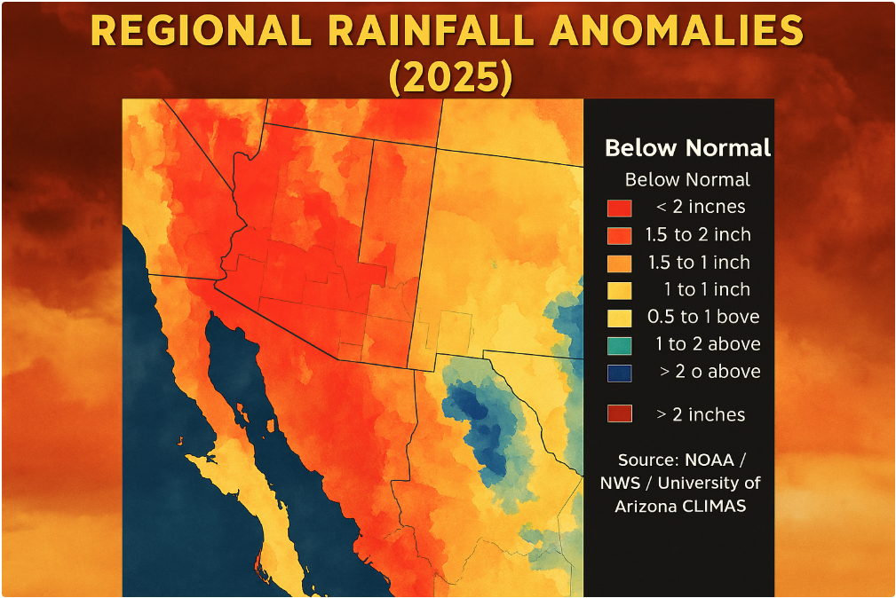
Rainfall Totals (Representative Cities)
Phoenix, AZ – 3.2 in (115%)
Tucson, AZ – 4.0 in (120%)
Las Vegas, NV – 1.1 in (90%)
Imperial, CA – 1.6 in (105%)
Albuquerque, NM – 3.5 in (95%)
St. George, UT – 2.0 in (110%)
Notes:
Annual rainfall:
Phoenix – 7.5-8.04
Tucson – 10.61-11.92
Las Vegas – 5
Imperial – 2.93
Albuquerque – 9.47
St. George – 8.30

Slide 8
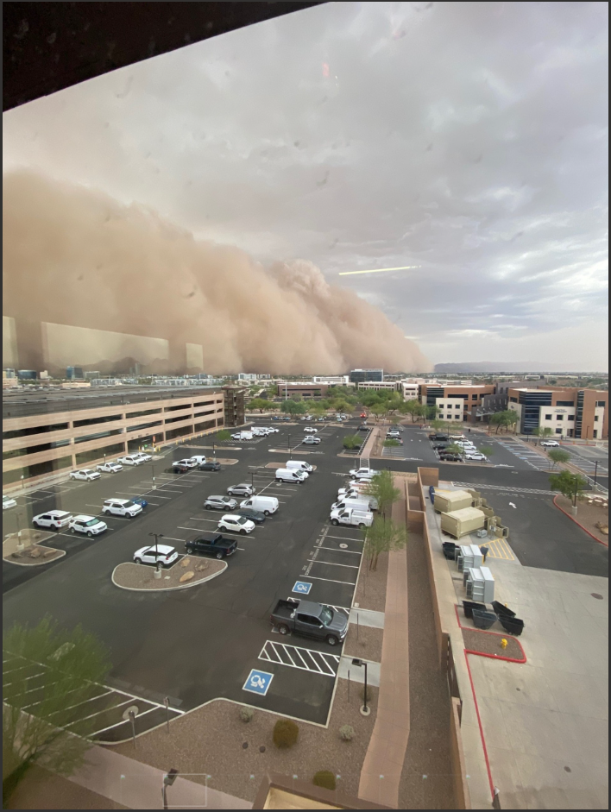
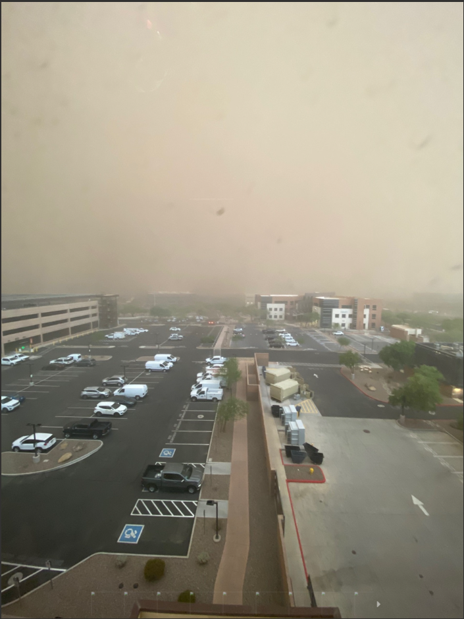
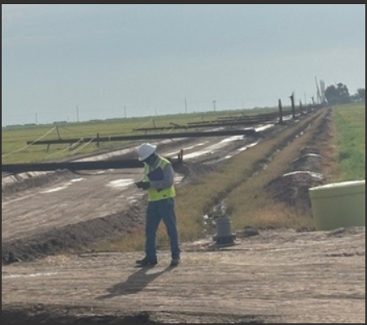
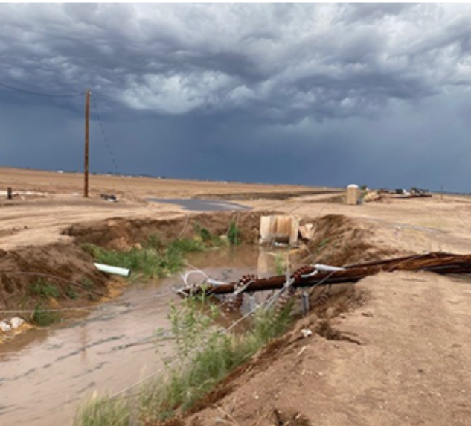
Discussion How did the monsoons impact your system? (Operational challenges, outages, emergency responses) What is your company doing to prepare for next monsoon season? (Mitigation plans, system hardening, coordination with neighbors)

Slide 9
Conclusion

