Slide 1
Iberian Peninsula Blackout
Contextual Comparison with North American BPS Reliability Safeguards
Mark Lauby, SVP, Chief Engineer

Slide 2
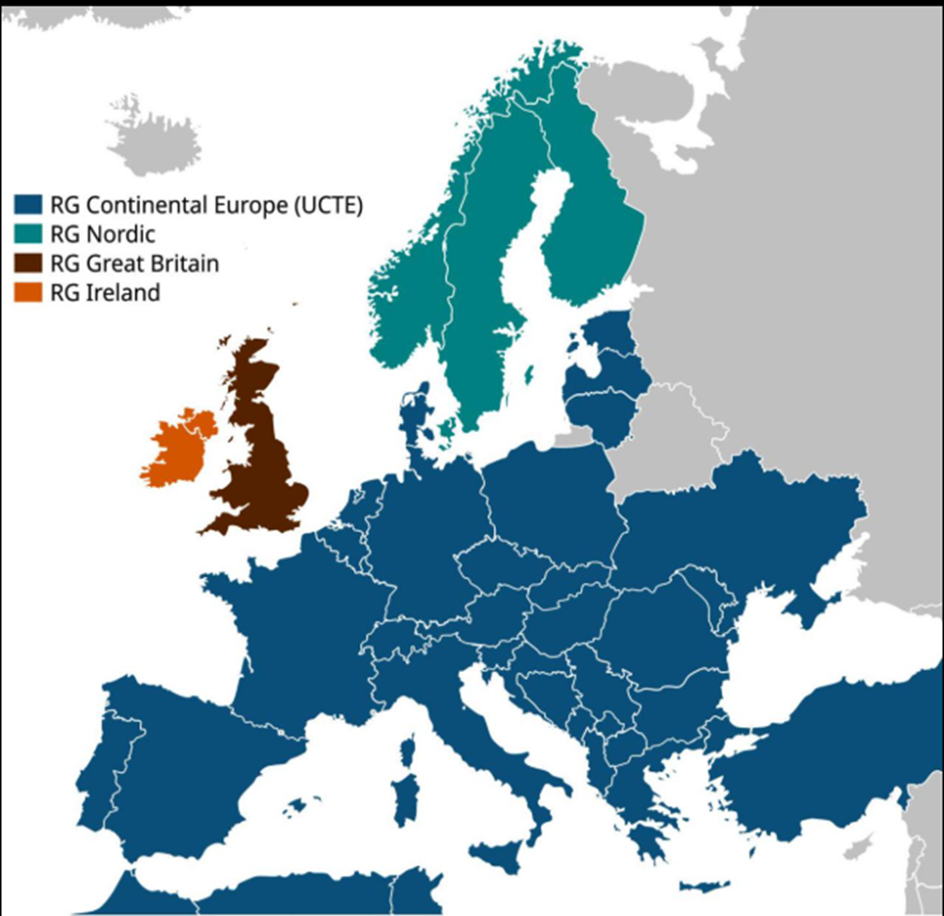
ENTSO-e Overview
European Network of Transmission System Operators for Electricity
  40 Transmission System Operations (TSOs)
  36 countries across Europe, beyond EU borders
  + 500 millions people served
  Nearly 300K miles of transmission lines
  + 1TW net generation capacity
  Consumption of 3,600 TWh
Spain
avg 61°F
Source: https://annualreport2017.entsoe.eu/about-entso-e/

Slide 3
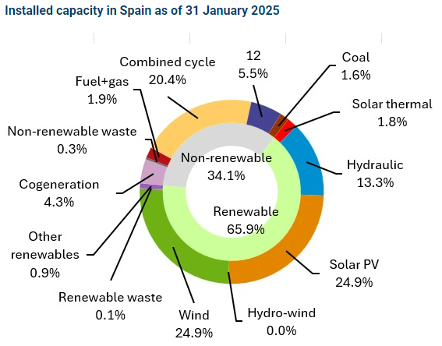
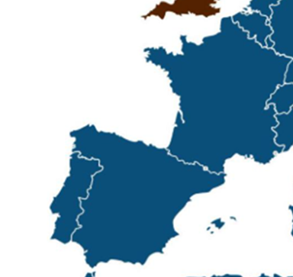
Spanish System Overview
Total Installed Capacity: 123 GW (66% renewable, 50% IBR)**
Total Installed Storage: 3.3 GW (mostly pumped hydro; < 50MW BESS)**
Total rooftop PV for self-consumption: ~ 8.5 GW***
Data Center load: ~ 1 GW ****
Spain
Spain
avg 61°F
Source: Red Electrica
Notes:
** https://www.sistemaelectrico-ree.es/en/spanish-electricity-system/generation/installed-capacity
*** https://www.pv-tech.org/spain-adds-1-4gw-of-self-consumption-pv-in-2024/
**** https://www.globenewswire.com/news-release/2024/10/21/2965953/28124/en/Spain-Data-Center-Market-Trends-and-Growth-Forecast-2024-2029-Tier-3-and-Tier-4-Facilities-Dominate-with-Expanding-IT-Load-Capacity-Cloud-Services-and-Colocation-Demand.html

Slide 4
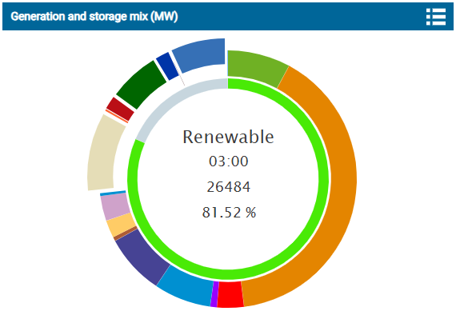
Pre-event Resource Mix
System Strength: Weak grid conditions - higher voltage sensitivity to network changes
Total load pre-event: 27 GW
Export pre-event: 1 GW to France, 2.8GW to Portugal, 800MW to Morocco
Pumped Storage
3GW consume
Wind
3.5GW, 11%
Export to Portugal
2.8GW
Solar PV
18GW, 55%
Cogen & Waste
1.4GW, 4%
Nuclear
3.4GW, 10%
Hydro Gen
3.2GW, 10%
Solar Thermal
1.5GW, 5%
* Source: REE, Generation Dashboard, April 28 2025

Slide 5
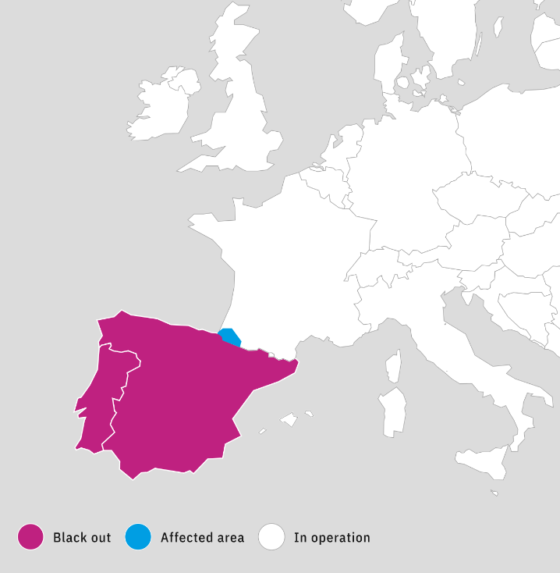
Blackout Event Overview
Affected: Portugal & Spain
  Small part of south France
April 28, 2025
12:33 CET – Black Out
12:35 CET – Black-Start began
13:04 CET – Morocco-Spain interconnector reenergized
13:35 CET – Eastern France-Spain interconnector re-energized
18:36 CET – Tie-line between Portugal and Spain re-energized
21:35 CET – 400kV tie-line Portugal and Spain re-energized
April 29
00:22 CET – Portugal transmission system restored
04:00 CET – Spain transmission system restored
France
Portugal
Spain
avg 61°F

Slide 6
Sequence of Event
 | 12:03 – 12:07 | Local oscillation between Spanish and Portuguese systems (0.6 Hz)
 | 12:16 – 12:22 | Inter-area oscillation (0.2 Hz), followed by rising voltage due to DER tripping
16 mins
 | 12:32:57 | Generation loss in Spain (355 MW, unknown type)
19 sec
 | 12:33:16 | Generation loss in Spain (727 MW, 1 PV, 1 unknown type)
1 sec
 | 12:33:17 | Generation loss in Spain (834 MW, 4 wind farms, 4 PV) Sharp voltage increase, triggering a cascade of additional generation losses
2 sec
 | 12:33:19 | Import from France reached 4,609 MW through AC ties. Iberian Peninsular system began to lose synchronism with the European system. Automatic load shedding began.
2 sec
 | 12:33:21 | AC lines between France and Spain were disconnected by loss of synchronism protection
3 sec
 | 12:33:24 | Spanish and Portuguese systems collapsed. HVDC lines stopped.
- Collector substation tripped due to overvoltage
- Some generators responsible for voltage regulation failed to perform
= total 2GW generation loss
27 sec

Slide 7
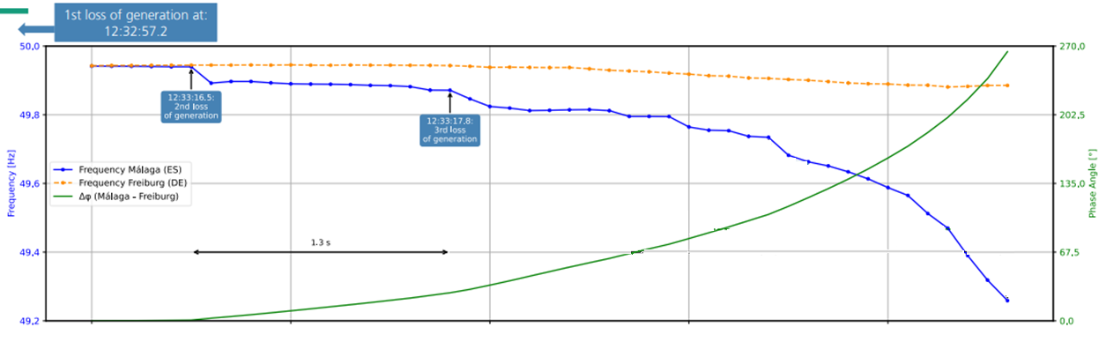
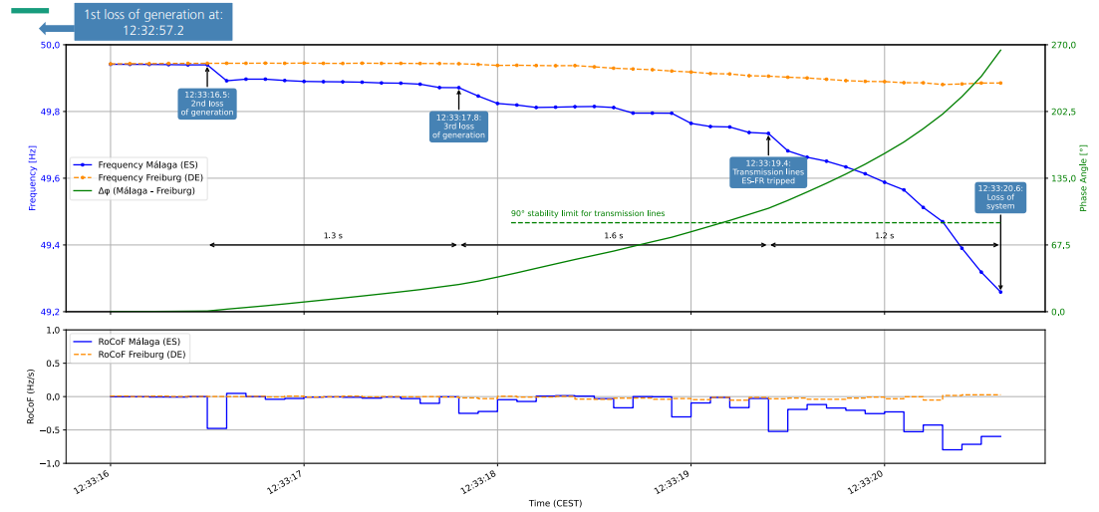
Frequency in Spain
12:33:16
2nd loss of gen
12:33:17
3rd loss of gen
12:33:21
Spain-France AC tie Tripped
Graph Source: Leonhard Probst, Scientist at the Fraunhofer Institute for Solar Energy Systems ISE

Slide 8
How It Happened
Oscillations
Mitigation Measures: Reduced Export, More lines
Initial Loss of Collector Substation due to Overvoltage
Less Line Loading -> More VARs
Lost VARs absorption from tripped Gens
More Generators Tripped due to Overvoltage
Load Shedding
Less Lines Loading -> More VARs
Less Line Loading -> More VARs
Lost VARs absorption from tripped Gens
Voltage
Voltage
Freq
Freq
Freq
Voltage
Freq
Freq
Insufficient Dynamic Voltage Regulation
Voltage
Freq
Voltage
“Each generation disconnection causes a slight increase of the voltage, which in turn causes the disconnection of other generators, producing a cascading phenomenon.” - REE

Slide 9
Primary Contributing Factors
Iberian Peninsula Blackout
Poor Voltage Ride-through Performance of Resources
Insufficient Dynamic Voltage Regulation
Unreliable Voltage Regulation of Conventional Generators
Potential gaps in Operations Planning
Lesson Learned for North America: If resource tripping is caused by overvoltage and results in underfrequency condition, UFLS will result in higher voltage in the absence of sufficient voltage regulation.

Slide 10
Relevant Measures in North American BPS
BPS Reliability
FAC, PRC and MOD Standards
NERC Alerts and Reliability Guidelines
VAR and BAL Standards
IRO, TOP Standards

Slide 11
Post-Event Recommendations by REE vs. North American BPS
Mandate all generation units, including IBRs capable of voltage regulation perform such control
We already do this!
Review of overvoltage protection settings
NERC Level 2 and Level 3 Alerts on IBR Performance Issues and Modeling Deficiencies
Enhancement of voltage control resources
Synchronous condensers and SVC/STATCOMs are already leveraged in North American BPS.
Define minimum monitoring requirements for incident analysis
New PRC-028: Disturbance Monitoring
NERC VAR-002-4 and FERC Order No. 827
Source: “Blackout in Spanish Peninsular Electrical System the 28th of April 2025” by the Spanish Transmission System Operator (TSO), Red Eléctrica

Slide 12
Recommendations in Spanish Government Report
Strengthen oversight and verification of regulatory compliance
Improve voltage control capabilities and oscillation damping
Increase interconnection with the European system
Review of services framework
Update system restoration procedures
Analyze and update operating procedures
Boost demand
Increase strength and flexibility
Source: “Report from the Committee for the analysis of the electricity crisis of April 28th 2025”, published by the Spanish government

Slide 13
Relevant On-going NERC Activities
FERC Order 901 Milestone 3 and 4 standard development projects
NERC work plan priority to develop a comprehensive framework to identify risks resulting from the transforming grid (e.g., inverter-based resources, large loads, essential reliability services)
Relevant essential reliability services include
  Inertia,
  Rate of Change of Frequency (RoCof),
  Frequency Response Measurement – ERO-wide performance assessment of BAL-003,
  Reactive Capability,
  Voltage Performance,
  System Strength (sensitivity to voltage magnitude and phase)

Slide 14
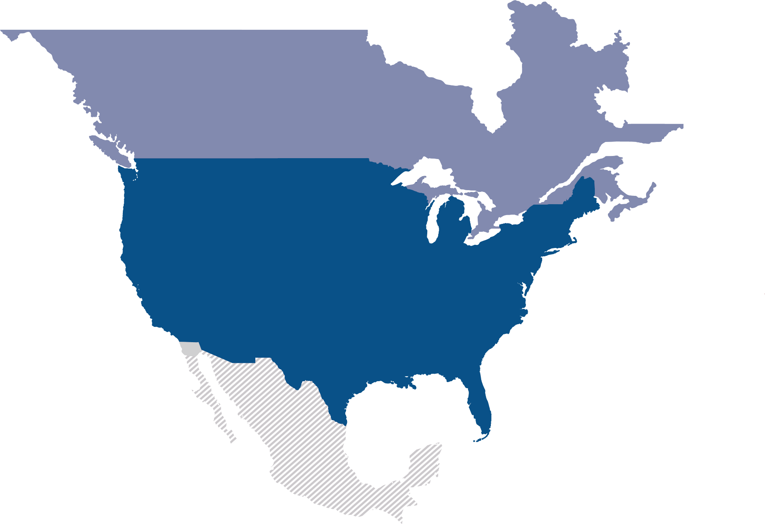
Questions and Answers

Slide 15
Backup Slides with Additional Info

Slide 16
Relevant Measures in North American BPS
Insufficient Voltage Regulation
NERC VAR-002-4 requires ALL generators to operate in automatic voltage control mode (unless otherwise instructed by TOP)
Unreliable Voltage Regulation
PRC-019-2: Coordination of Generating Unit or Plant Capabilities, Voltage Regulating Controls and Protection
FERC Order No. 827: Mandatory Automatic Voltage regulation
NERC Level 3 Alert, Essential Action #3 (for TOs, TPs, PCs), #4 (for GOs)
MOD-026: Periodic model verification against plant performance
NERC Level 3 Alert, Essential Action #4 (for GOs)
NERC Level 2 Alert IBR Performance Issues, Recommendation 6
NERC VAR-001-5: Voltage and Reactive Control

Slide 17
Relevant Measures in North American BPS
Poor Voltage Ride-through Performance of IBRs
Active Power Frequency Control
Primary Frequency Response (FERC Order No. 842)
PRC-024-4: Synchronous machine voltage and frequence trip settings
PRC-029-1: IBR Ride-through performance
PRC-030-1: Unexpected IBR Event Mitigation
FAC-008-5: Facility ratings
NERC Level 2 Alert IBR Performance Issues, Recommendation 1, 2, 3, 4
NERC Level 3 Alert Essential Actions #1
Fast Frequency Response (in select region)
BAL-002-3: Identify and have reserve for most severe single contingency
BAL-003-2: Maintain Interconnection frequency within predefined bounds
NERC Level 3 Alert Essential Actions #1

Slide 18
Relevant Measures in North American BPS
Reliability Operations
IRO-008-3: Reliability Coordinator Operational Analyses and Real-time Assessment
Operations Planning
IRO-009-2: RC Actions to operate within Interconnection Reliability Operating Limit
TOP-002: Analysis to identify and avoid unstable operating conditions
TOP-003: Maintain situation awareness for real-time operation
TOP-010 and IRO-018: Quality of analysis for real-time assessment
FERC Order No. 901 – Directive to study more variety of contingencies and operating conditions
FAC-011-4: System Operating Limits Methodology for Operations Horizon

Slide 19
Relevant Measures in North American BPS
System Restoration
EOP-006-3: System Restoration Coordination
Effective UFLS Operation
PRC-006-5: Automatic UFLS
PRC-008-0: UFLS Equipment Maintenance Programs
PRC-012-2 & PRC-017-1: Remedial Action Scheme
EOP-005-3: System Restoration from Blackstart Resources

