Slide 1
Western Transmission Expansion Coalition
"WestTEC"
Public Webinar
November 22, 2024
Notes:
Welcome
Purpose of webinar:
To share high-level updates on WestTEC’s efforts since the last update in June
To provide an overview of the study plan and feedback received from WestTEC committees to-date and describe the upcoming public comment opportunity for regional partners
To describe next steps in executing the study
Housekeeping items:
Meeting is being recorded, will be posted to WPP website
If you have questions along the way, encourage you to use the Zoom Q&A function to ask your questions.
We will take questions at a good mid-way pointe in the meeting as well as at the end of the meeting—those entered into Q&A as well as verbal questions. Please raise your hand at the end of the meeting if you would like to ask your question verbally.

Slide 2
Agenda Overview
WestTEC Overview and Announcements
Updates from Committees, States and Tribes
Study Execution Update
Capacity Expansion Modeling Overview
Public Workshop of Scenario Drivers
Action Items and Next Steps
Notes:
Sarah
Logistics: take questions throughout presentation, can be sent in through chat or zoom Q&A or you can raise your hand to ask a question.

Slide 3
The Presentation Team
Western Power Pool: Sarah Edmonds
Consultants:​
  Energy Strategies: Keegan Moyer​ and John Muhs
  E3: Jack Moore
  GDS Associates: Gillian Biedler
Steering Committee Co-Chairs: Kelsey Martinez, PNM, John Martinsen, Snohomish PUD
WATT Co-Chairs: Jennifer Galaway, Portland General Electric, Biju Gopi, CAISO (Alt), Ben Fitch-Fleischmann, Interwest Energy Alliance​
Regional Engagement Committee (REC) Co-Chairs: Vijay Satyal, Western Resource Advocates, Robb Davis, GridLiance​
Tribes: Donald Williams, From the Light Consulting​
CREPC TC: Robin Arnold, Western Interstate Energy Board
Notes:
Sarah

Slide 4
WestTEC Overview
Notes:
Sarah

Slide 5
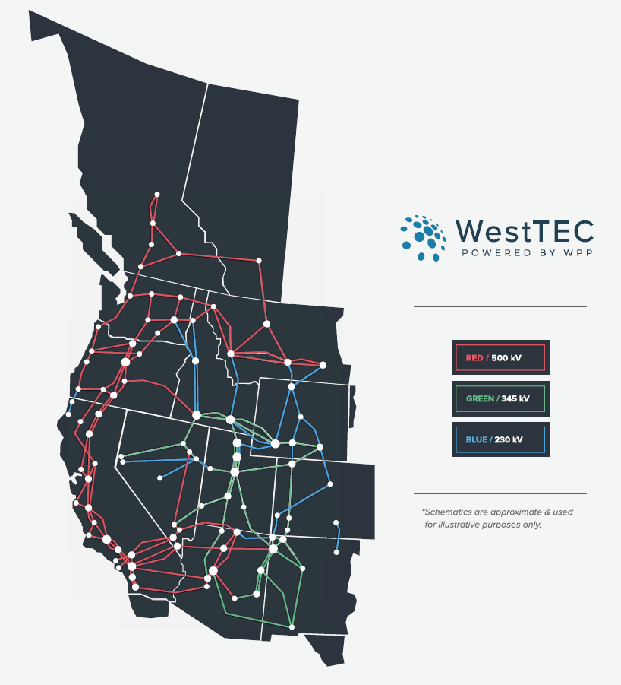
What is the Western Transmission Expansion Coalition?
“WestTEC”
Not a FERC process
West-wide 20-year transmission study (10-year look)
Industry-led with unprecedented regional partner inclusion
Goal is to produce an actionable transmission study
Notes:
Sarah

Slide 6
WestTEC Project Timeline
NEAR-TERM PLANNING HORIZON EFFORTS
LONG-TERM PLANNING EFFORTS
PROJECT DISTRIBUTION & REGIONAL PARTNER ENGAGEMENT
QUARTERLY PUBLIC ENGAGEMENT
2024
Q3
2024
Q4
2025
Q1
2025
Q2
2025
Q3
2025
Q4
2026
Q1
2026
Q2
2026
Q3
2026
Q4
2027
Q1
Oct 21: CREPC-TC Meeting
Mar 2025:
Steering Approves Scenarios
July 2026: Planning Scenarios Complete
Nov 19: All-Committee Meeting
Sept 2024: Final Study Plan
Feb:
Public Workshop
Aug 2025: Initial 10-year Horizon Report Complete
Sept 2026: Completion of 20-year Horizon Report and Final 10-year Horizon Report
Nov 22:
Public Workshop
Feb: CREPC-TC Meeting

Slide 7
Committees, States, and Tribes Update

Slide 8
Study Execution Update

Slide 9
Technical Status Update
Significant progress has been made developing the 10-year Reference Case, which is a trendline view of 2035 that will be used to assess nearer-term interregional transmission needs and will service as the starting point for 20-year assessments
  This consists of forecasts for load, generation, and transmission for the 2035 study horizon – see subsequent slides
Energy Strategies and the WATT have been finalizing study methodologies for the System Reliability Assessment
  The team will begin work refining other methods (e.g., Interarea Deliverability Assessment) soon
Energy Strategies and E3 have been coordinating baseline assumptions and data handoffs to support execution of 20-year assessment in 2025
  See next section for details on E3 capacity expansion modeling

Slide 10


10-year Reference Case Load Forecast: Demand
The WestTEC 2035 Reference Case load forecast represents a significant increase in demand over the approaching 10-years
  ~9% higher loads than WECC 2034 ADS
  34% increase from 2023 actual loads (~2.4 CAGR)
The National Transmission Planning Study featured CAGR of 2% and 2.7% for Mid and High Demand scenarios, respectively
Metric | 2023 Actual | 2034 ADS | 2035 WestTEC
10-year CAGR | N/A | 1.9% | 2.4%
Coincident Peak (MW) | 170,656 | 204,502 | 218,687
Annual Energy (GWh) | 932,989 | 1,142,100 | 1,245,837
Notes:
Forecasts of demand response and distributed generation not shown but reflect aggregation of levels identified in review of utility IRPs

Slide 11
10-year Reference Case Load Forecast: System Reliability Assessment
WECC summer coincident peak occurs in July at Hour 19
WECC winter coincident peak occurs in December at hour 20
Cases are reflective of system conditions for season and hours adjacent to this time
Net WECC (aGW) | 1 | 2 | 3 | 4 | 5 | 6 | 7 | 8 | 9 | 10 | 11 | 12 | 13 | 14 | 15 | 16 | 17 | 18 | 19 | 20 | 21 | 22 | 23 | 24
Jan | 128 | 125 | 122 | 121 | 122 | 127 | 136 | 145 | 147 | 143 | 137 | 132 | 129 | 128 | 128 | 131 | 137 | 147 | 156 | 157 | 154 | 149 | 142 | 134
Feb | 127 | 123 | 121 | 120 | 121 | 126 | 135 | 143 | 141 | 134 | 127 | 121 | 118 | 117 | 117 | 120 | 127 | 138 | 148 | 153 | 151 | 147 | 140 | 133
Mar | 119 | 116 | 114 | 114 | 116 | 123 | 131 | 134 | 131 | 125 | 119 | 115 | 112 | 111 | 112 | 114 | 119 | 128 | 137 | 143 | 144 | 139 | 131 | 124
Apr | 115 | 111 | 109 | 109 | 111 | 116 | 120 | 119 | 116 | 112 | 109 | 107 | 106 | 107 | 109 | 113 | 118 | 126 | 134 | 138 | 139 | 136 | 128 | 121
May | 119 | 114 | 111 | 109 | 110 | 113 | 114 | 114 | 114 | 114 | 113 | 113 | 115 | 117 | 120 | 125 | 130 | 136 | 143 | 146 | 145 | 142 | 134 | 125
Jun | 130 | 123 | 119 | 117 | 116 | 118 | 118 | 119 | 120 | 122 | 124 | 126 | 130 | 135 | 140 | 147 | 153 | 160 | 165 | 167 | 164 | 158 | 149 | 138
Jul | 137 | 131 | 126 | 123 | 123 | 124 | 123 | 124 | 126 | 130 | 134 | 140 | 146 | 153 | 161 | 168 | 174 | 179 | 183 | 183 | 178 | 170 | 159 | 147
Aug | 136 | 129 | 125 | 123 | 123 | 126 | 127 | 126 | 127 | 129 | 133 | 137 | 143 | 150 | 158 | 165 | 172 | 177 | 181 | 179 | 174 | 165 | 154 | 143
Sept | 124 | 119 | 116 | 114 | 115 | 119 | 123 | 121 | 119 | 120 | 123 | 126 | 131 | 137 | 145 | 153 | 160 | 167 | 170 | 168 | 162 | 152 | 140 | 130
Oct | 115 | 112 | 109 | 109 | 111 | 118 | 126 | 127 | 125 | 121 | 119 | 117 | 117 | 118 | 120 | 125 | 132 | 142 | 147 | 148 | 144 | 137 | 128 | 121
Nov | 121 | 117 | 115 | 114 | 115 | 120 | 129 | 134 | 132 | 128 | 123 | 120 | 119 | 119 | 121 | 126 | 135 | 146 | 153 | 151 | 148 | 143 | 135 | 128
Dec | 131 | 127 | 124 | 123 | 124 | 128 | 136 | 145 | 146 | 143 | 137 | 132 | 129 | 128 | 128 | 132 | 141 | 151 | 160 | 159 | 157 | 153 | 146 | 138

Slide 12
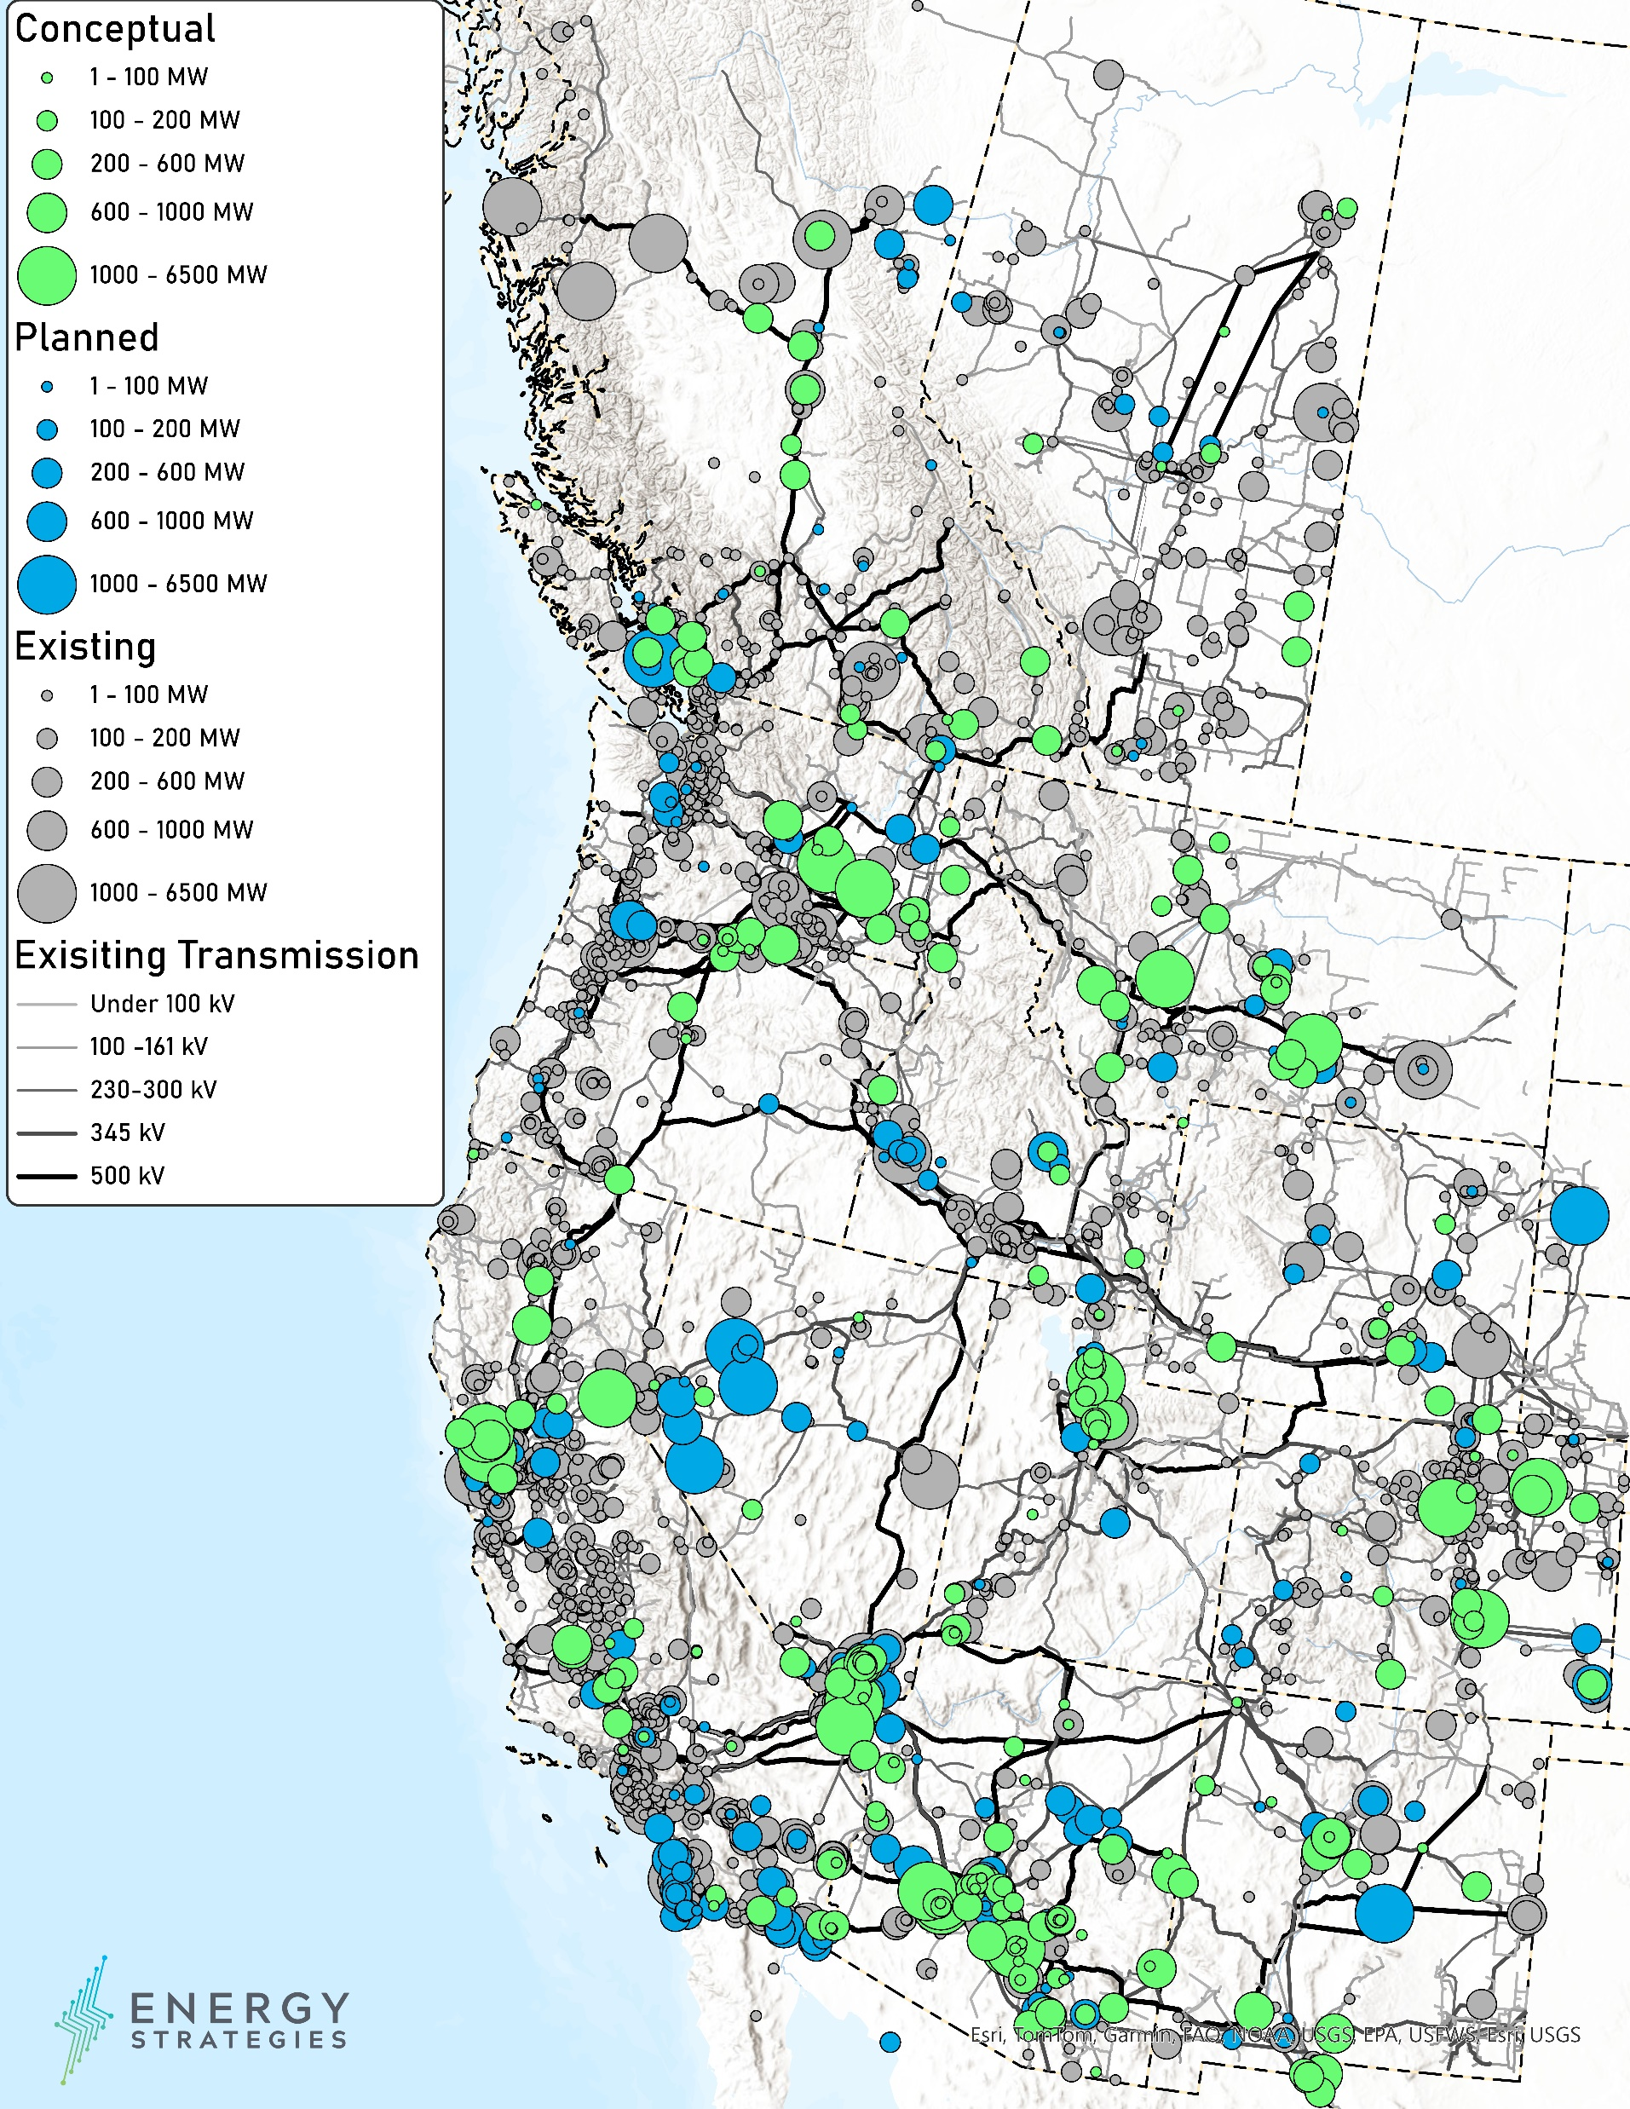
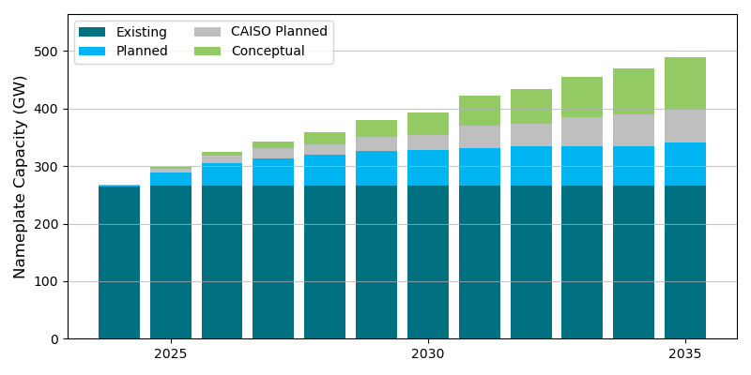
WestTEC Resources by Status (through 2035)
Existing generation and retirement dates validated via IRP review
Planned generation builds are “firm” new additions
Conceptual resources are those that represent generic but planned expansions to meet utility energy, demand or policy needs
Approximately 1/3rd of 10-year resource additions are planned resources that will come online over the next 5-6 years
Notes:
MENTION CAISO

Slide 13
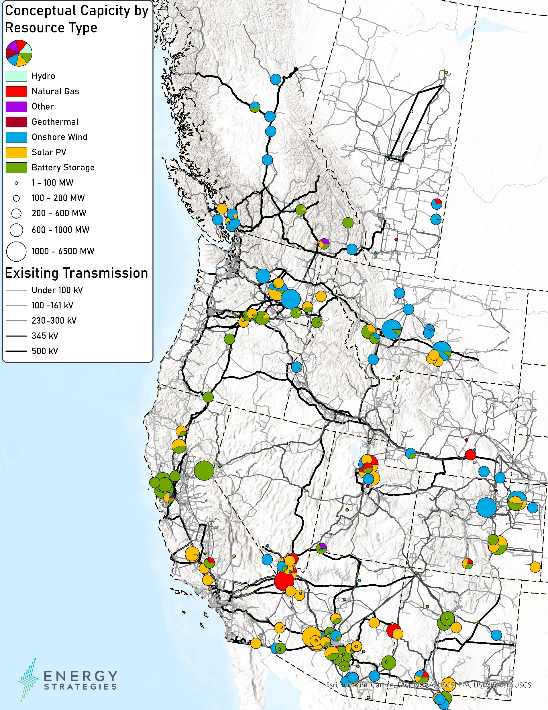
WestTEC Conceptual Resource Additions by Type
(through 2035)
A busbar mapping assigned conceptual resources to probable and viable points of interconnection (buses). This process included:
  Compiling IRP conceptual capacity (MW) by region & resource type
    Adjusting for out-of-region procurements, if applicable
  Mapping conceptual resource additions to a rank-ordered list of 230kV+ interconnection points (buses) in each region
    Bus rank was determined by a multi-factor score that considered commercial interest (queue data), land characteristics, and transmission network connectedness considerations
  Refining mappings based on engineering judgement and local expertise

Slide 14
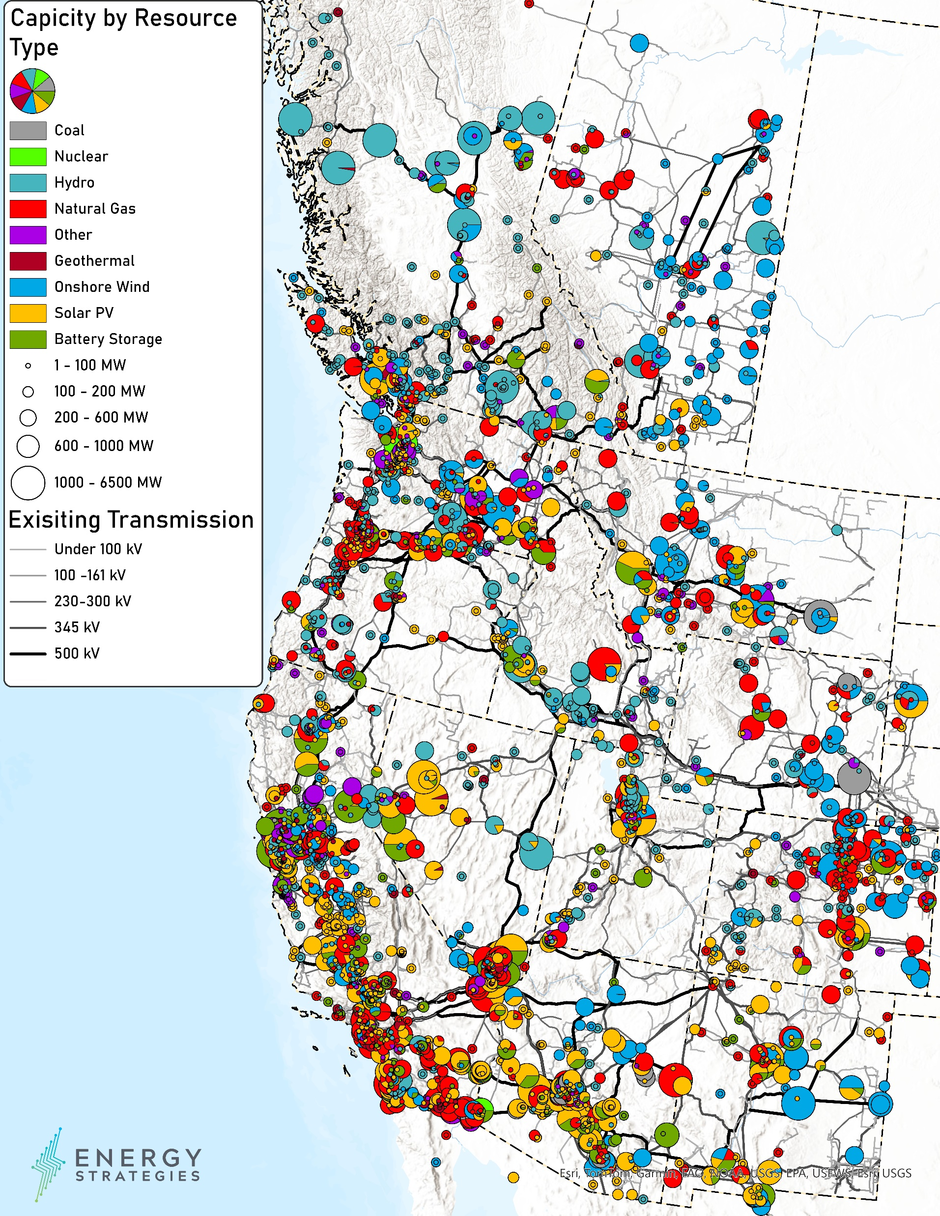
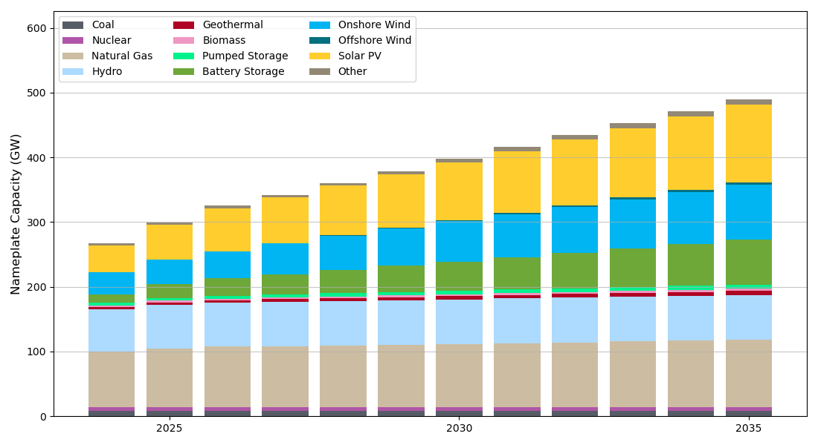
WestTEC Resource Mix (2035)
WECC Capacity by Resource Type (GW)
WECC system resources projected to grow by ~20 GW/yr in next decade mostly from wind, solar, batteries, and natural gas

Slide 15
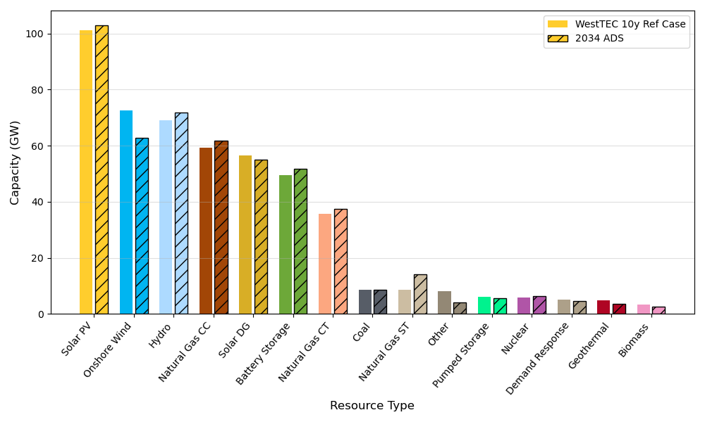
WestTEC 10-year Reference Case trajectory is consistent with WECC 2034 ADS
WECC Capacity by Resource Type

Slide 16
Notable Transmission Projects included in 10-year Reference Case
The following list is a list of notable projects that are regional in nature or are >300-kV, with some exceptions for certain 230-kV projects
  The list does not include all projects that will be included in the WestTEC 2035 Reference Case, but captures major topology changes
Not final and subject to change
Notes:
Bolo Tie

Slide 17
Study Execution: Next Steps
Complete further data collection and model calibration/testing required for 2035 assessment [November/December]
  Methods will be refined January
Complete Powerflow Assessment and refinement of hypothesis map [March, 2025]
Complete Congestion Assessment and refinement of hypothesis map [April 2025]

Slide 18
Capacity Expansion Analysis for the WestTEC Transmission Study
Methodology Overview
November 19th, 2024
Arne Olson, Senior Partner
Jack Moore, Senior Director
Femi Sawyerr, Senior Managing Consultant

Slide 19
Content
The Role of Capacity Expansion Analysis in the WestTEC Study Plan
  WestTEC project workflow
  Overview of capacity expansion analysis
Capacity Expansion Methodology for WestTEC Analysis
  Capacity Expansion Problem Formulation
  Topology
  Additional Inputs and Assumptions
  Resource Costs
Current Status of E3 Load Forecast Development
  Overview of E3 load forecast process
  Total load buildup
  Data center load projections

Slide 20
Role of Capacity Expansion Analysis in the WestTEC Study Plan

Slide 21
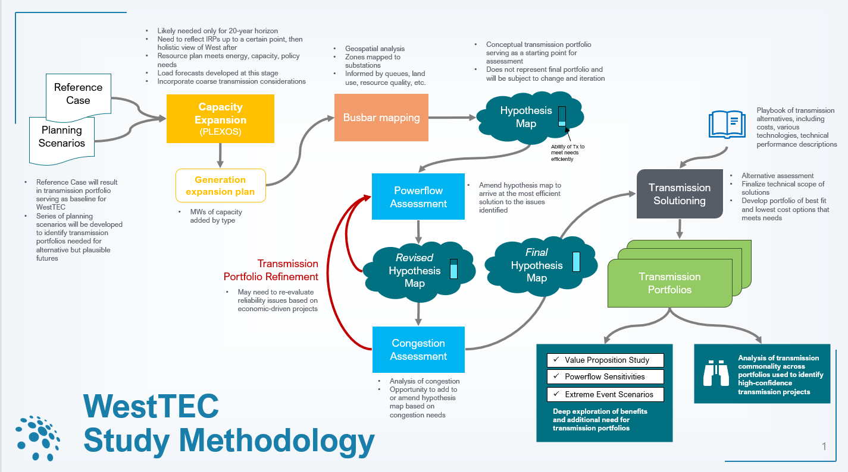
Capacity Expansion Roel in WestTEC Project Workflow

Slide 22
Overview of Capacity Expansion Analysis
E3 is leading the capacity expansion analysis, utilizing the PLEXOS LT model to co-optimize intrazonal generation and storage resource portfolios, and inter-zonal transmission resources over the entire Western Interconnection.
The optimization will create portfolios that will incorporate the following in each of the modeled zones:
  Meet hourly load and reserve requirements
  Respect policy and voluntary goals
  Respect resource availability limits
  Result in the lowest Western-system-wide capital, dispatch, and penalty costs (if applicable)
The goal of the capacity expansion analysis is to create 20-year resource portfolios for each zone, which:
  incorporate generation, load, and transmission information from the 10-year study as base inputs
  utilize new load forecasts data that are being developed using a bottom-up approach
  utilize the latest generation, storage, and transmission resource costs and performance assumptions
  utilize scenario analysis to consider multiple potential future realities

Slide 23
Capacity Expansion Methodology

Slide 24
Capacity Expansion Problem Formulation
Capacity expansion is typically performed as a constrained optimization:
  Minimize the cost of
  [generation build cost + transmission build cost
  + system operations cost (fuel cost, O&M cost, emissions permit cost, etc.)
  + penalty cost for unserved load or other system problems]
  Subject to:
    Hourly energy balance: Generation + net imports for each zone = load for each zone
    Reliability requirements: Planning reserve margin or other proxy for minimizing target loss of load
    Policy requirements: GHG and/or RPS targets
    Build limits to resource & transmission available potential given to model by zone
    Operating & flexibility reserve limits (if applicable)
Model runs iteratively to select different resource additions that reduce total cost of build and operations while satisfying the constraints
  Will use sampled chronology of selected days & years to make model computable for the large Western footprint

Slide 25
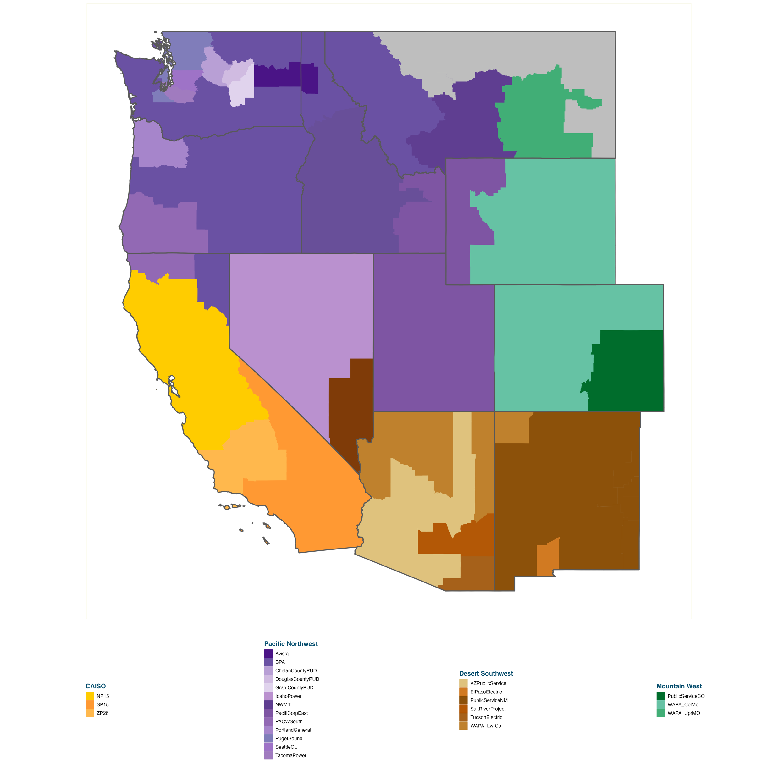

Zonal Topology Represents the Entire Western Interconnection
The model footprint covers the entire
WECC system
  Including British Columbia, Alberta, and Baja California
Most zones follow balancing authority (BA) boundaries
  CA is split into its three market zones
Transmission constraints are simplified and aggregated at the zonal level
  Sub-zonal line constraints are not captured
BCHA and AESO are included in the modeling.
Areas in gray indicate zones in either SPP or MISO.
Baja California is also included in the modeling.

Slide 26
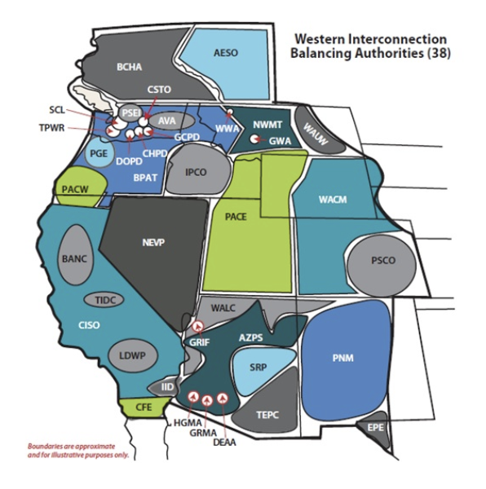
Key inputs
Fundamental:
Zone definition
Policy goal & reliability definition
Penalty costs as appliable (e.g. unserved energy, reserve shortage, renewable curtailment)
Initial conditions:
Existing zone-to-zone transmission capability (in MW) [incl any multi-zonal constraints]
Zonal hourly load
Initial zonal resource build (MW by technology) from the 10-year reference case
Characterization of initial resources operating capability & cost
Additional planned retirements/additions
Fuel costs, GHG permit costs
Out of market import schedule or cost
Transmission hurdle rates for wheel out/through
Constraints:
Reliability requirement target
Policy goal target (RPS/GHG)
Existing zone-to-zone transmission capability (in MW)
Operating & flexibility/forecast error reserve requirements to hold
New options available to select:
New generation technologies menu & characterization (including hourly shape)
Zonal additional potential (MW by technology) available to select
Build & operating cost of potential new additions (by technology by zone)
New transmission potential capability (MW of capability by selected zonal pair)
Cost of new transmission additions (capital & operating)

Slide 27
Key outputs
For each zone: Resource build in MW for each zone for each major technology
Transmission build at zone-to-zone level (with MW capability addition)
Resulting cost:
  Resource build capital cost
  Transmission capital cost
  Annual fixed O&M
  System dispatch cost (fuel cost, variable O&M)
  Penalty costs for curtailment, unserved energy, etc.
Resulting operations:
  Dispatch by resource
  Fuel burn, capacity factors, renewable curtailment, load curtailment, reserve margins
  Flow & congestion by transmission zone-to-zone ”link”

Slide 28
E3 Resource Cost Estimates
Recost Model Overview
E3’s Recost model calculates levelized fixed costs (LFC) and the levelized cost of electricity (LCOE) for a range of conventional and emerging technologies
  LFC is reported in $/kW-yr, and LCOE is reported in $/MWh
LFC and LCOE are calculated by initial commercial operations date (COD), from 2025 through 2050
Recost estimates are calculated using inputs from various sources:
E3 Recost
Inputs (Database)
Outputs (Calculations)
Technology Operations Assumptions
Sources: NREL, EIA, PNNL, Market Data
Levelized Costs
Outputs: LFC, LCOE
Technology Cost Assumptions
Sources: NREL, EIA, PNNL, Market Data
Results Validation
Technology Financing Assumptions
Sources: Market Data, NREL, PNNL
Discounted Cash Flow Model
Outputs: NPV, IRR

Slide 29
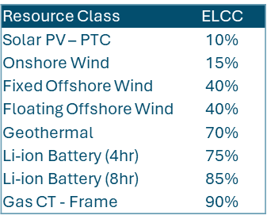
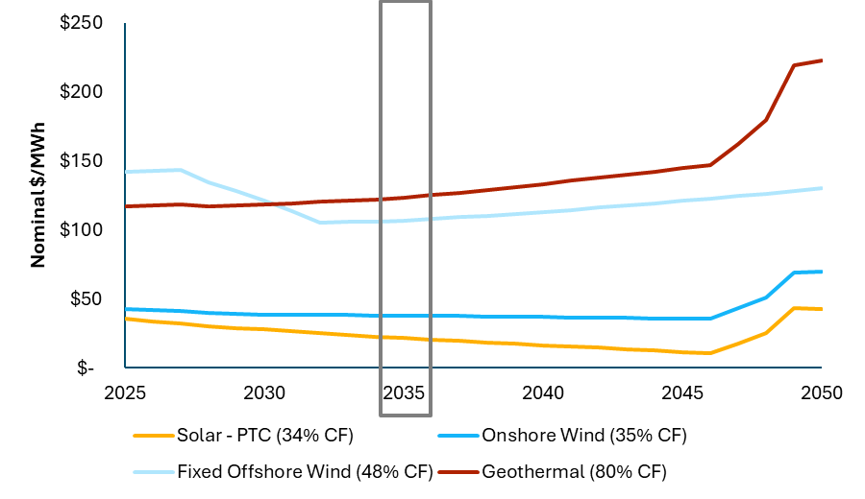
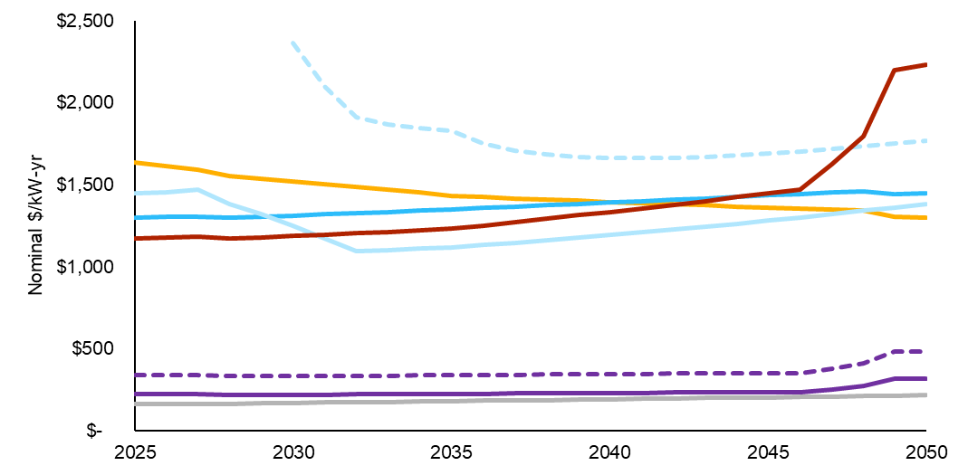
Resource cost forecast will utilize E3’s latest projections
Production Tax Credits drive LCOE outcomes: Solar eligibility for the PTC makes this the rational election for new generators in areas with good resource potential, despite the greater recapture risk.
Clean, firm, dispatchable generation capacity carries a consistent cost premium: while geothermal cost declines are expected over time in real terms, nominal costs increase and emerging competitor technologies are more competitive in many cases (e.g., gas CCGT with CCS).
Energy storage costs favor lithium-ion batteries, for now: while certain configurations of Pumped Storage Hydro (PSH) enjoy a current cost advantage to Li-ion batteries (including ITC), emerging longer-duration storage technologies may further erode lithium’s advantage in the future.
E3 Levelized Cost of Energy Estimates for Selected Resources
E3 Levelized Fixed Costs of Capacity Estimates for Selected Resources
Technology costs in this deck represent non-specific, indicative nationwide averages for CAPEX, LFOC, and LCOE. ELCC and Capacity factors are indicative. LCOE is not used as an input in IRP modeling and is reported as reference only. Final resource costs for use in modeling will be localized to account for regional changes in CAPEX, O&M, IX, and taxes.

Slide 30
Load Forecast Development

Slide 31
E3 Load Forecasting Process
Annual Energy of Individually Modeled “Load Categories”
Hourly Load Profile:
E3
LDV managed
EV Charging
LDV Unmanaged
MHDV
Load Shape
Res./Com. Heat Pump
Peaks
Building Electrification
Annual Energy
Regional Load Forecast Sources
(e.g. FERC714, E3 PATHWAYS,
ISO forecasts, etc.)
Total Annual Energy
Res./Com. Electric Resistance
Parse Loads into Load Categories
Data Center
PLEXOS Build Tool
Input:
- Base Profile (MW)
- Annual Energy (GWh)
- Maximum Annual Peaks (MW)
BTM Solar
Gross Load
Data Center
BTM Solar
Net Electric Load**
Hourly Loads for all years
(Year-Month-Day x 24 Hours)
Net Electric Load**
**Net Electric Load represents load net of BTM PV and all other modeled load categories.
E3 will use the median weather year for determining the net electric load shape

Slide 32
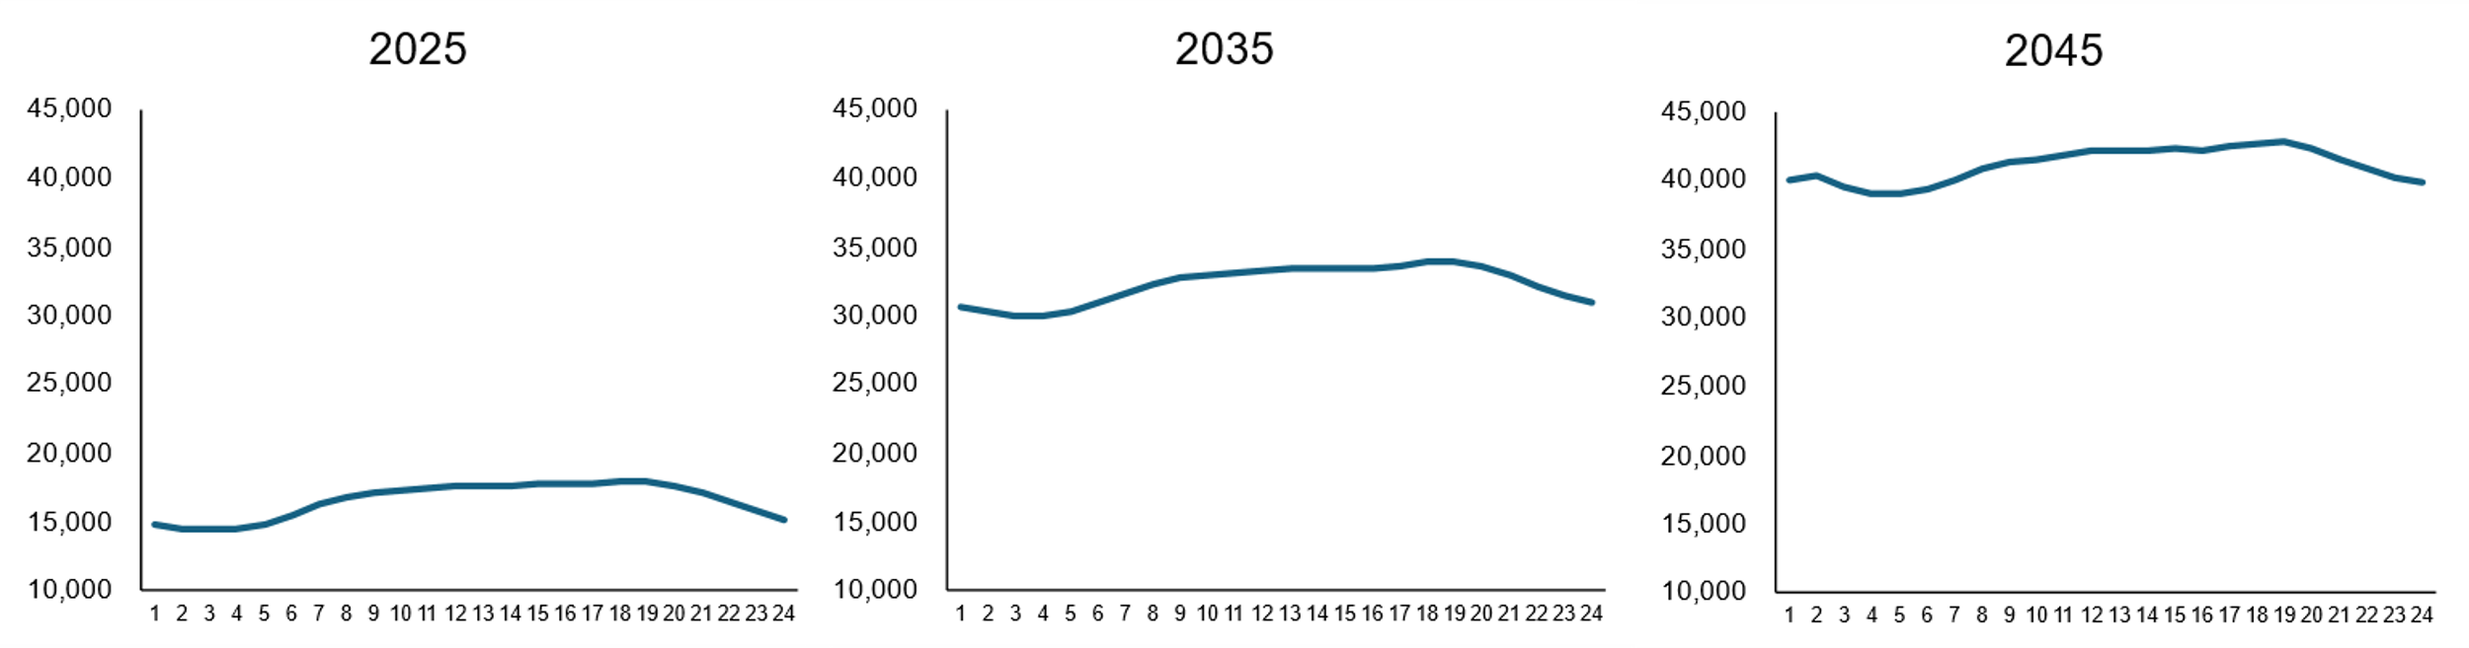
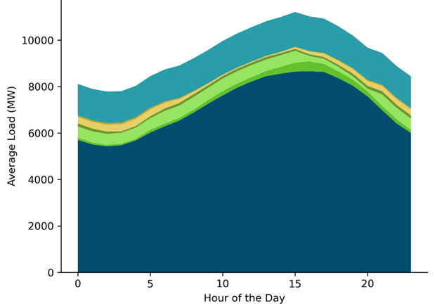
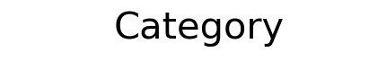
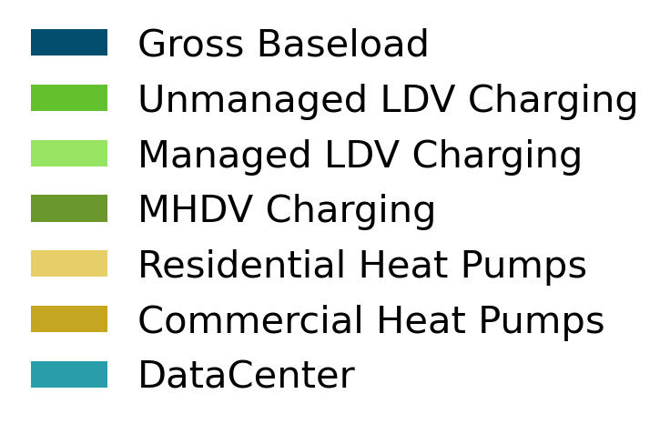
Total Load Buildup
Average Hourly Load Shape (Illustrative)
PLEXOS generates hourly loads for each load category in each transmission zone based on inputs from E3 load forecasting toolkit
Each load type is summed for each hour to assess total energy and peak demand
MW
Illustrative Average Hourly Load Stack, 2050
Hour of Day
Total Gross Load Build-Up
1. Gross Baseload
2. Residential and Commercial Heat Pumps
3. Light Duty Vehicle Charging (Managed and Unmanaged)
4. Medium-Heavy Duty Vehicle Charging
5. Data Centers
Total Gross Load = Gross Baseload + Heat Pumps + EV Charging + Data Centers

Slide 33
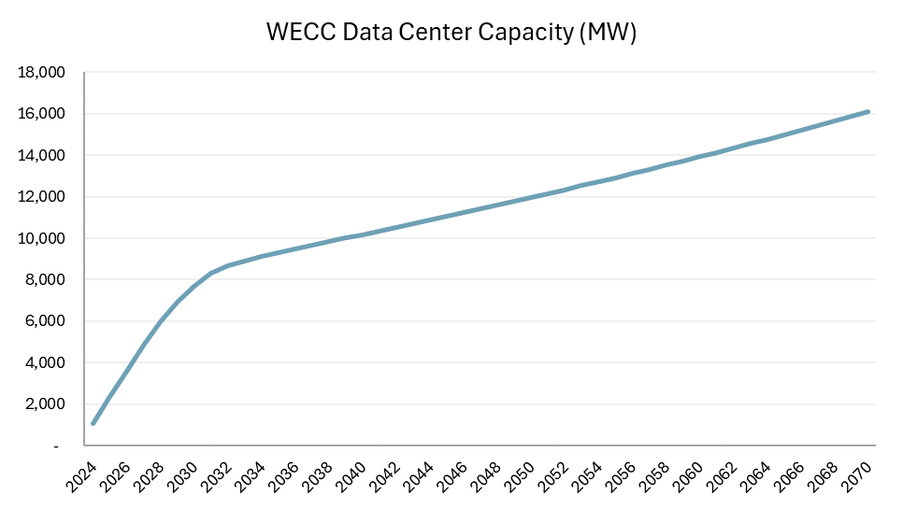
2024 E3 WECC-Wide Incremental Data Center Projections
Total ~80 TWh
by 2045
12% CAGR (2024-2045)
Data center demands are concentrated across just a few regions

Slide 34
Arne Olson, arne@ethree.com
Jack Moore, jack@ethree.com
Femi Sawyerr, femi@ethree.com

Slide 35
Public Workshop on Scenario Drivers

Slide 36
Agenda
Overview of WestTEC Scenario Planning Effort & Slido Setup
Interactive Primer for Scenario Discussion
Presentation of Scenario Drivers
Interactive Feedback Session on Scenario Drivers
Q&A
Notes:
Saved scenario discussion for last because thinking of scenarios and their impacts to modeling requires a knowledge of the modeling

Slide 37
Focus of Scenario Planning Effort
The scenario planning sub-team is facilitating the development of two alternative scenarios in the 20-year horizon
Scenarios consider variations in things like technology advancement, load growth and policy changes
Scenario results will be used to identify persistent transmission needs across a range of future outcomes
Current System (Not Modeled)
10-year Reference Case
20-Year Reference Case
Scenario A
Today
2035
2045
Scenario B
Notes:
Saved scenario discussion for last because thinking of scenarios and their impacts to modeling requires a knowledge of the modeling

Slide 38
Scenario Drivers
Scenario Planning Development Schedule
Milestone | Completion Date
Phase 1 Commences
Scenario sub-team develops scenario development process | September 1, 2024
WATT/REC joint session to review scenario development process | September 3, 2024
Steering Committee approves scenario development process | September 10, 2024
Scenario sub-team develops an initial list of drivers | October 2, 2024
Scenario sub-team will seek full REC, WATT, and Steering input on drivers (joint session 1) | October 8, 2024
Sub-Team Debrief meeting on REC/WATT/Steering Input | October 9, 2024
CREPC-TC session to get input on drivers | October 21, 2024
Public workshop on drivers | November 15 22, 2024
All Committees In-Person Meeting to finalize drivers (joint session 2) | November 19, 2024
Phase 2 Commences
Scenario sub-team works with E3 to build scenarios | December 1-24
Sub-team will host a REC, WATT and Steering joint session to get input on scenarios | January-25
Sub-team will host a CREPC-TC meeting to get input on scenarios | February-25
Sub-team will host a public workshop to get input on scenarios | February-25
Steering approves scenarios | March-25
Planning scenarios complete | July-26

Slide 39
Scenario Narratives
Scenarios are intended to be plausible visions of the future
  Scenario planning is used to inform decision-making today by testing our assumptions about uncertain future outcomes
Key to determining scenarios are scenario narratives
  Scenario narratives ensure that future scenarios are plausible and coherent
Notes:
- Approach to developing scenarios was adopted from that used in long-term planning by oil companies (Shell) in the 1970s
Used to justify decision-making & investments in large infrastructure like offshore drilling platforms during volatile and uncertain future oil markets
Their idea of scenario planning is not so much that you’re trying to predict the future as much as develop multiple plausible visions of the future
The goal is that you can suspend disbelief that any one of them might occur
Scenario planning is also a process that helps us test our assumptions
Scenario narratives help us understand how the same set of drivers might act/influence each other differently in different futures
The westTEC is a voluntary and bold study plan, so the intention is that we can be dynamic enough to reflect a wide range of concerns and uncertainties in our scenarios
There are many

Slide 40
Drivers: Building Blocks of Scenarios
Drivers represent important or uncertain forces that impact scenario narratives in the 20-year study horizon
  Sub-team focused on drivers that were viable from a modeling standpoint, measurable, and relevant to study objectives
Drivers help to inform the impacts to one or more modeling assumptions that are then made consistent across the modeling effort
The upcoming interactive session will walk through some of the considerations the sub-team made when developing a list of drivers
Notes:
What is a driver?

Slide 41



Please download and install the Slido app on all computers you use
Join at slido.com
#3443947
ⓘ Start presenting to display the joining instructions on this slide.
Notes:
When you scan the QR code, you will join the slido survey that we’ve prepared for today.
The questions will automatically update and change with the presentation.
By default your responses will be anonymous, but if you’d like your name to be associated with your response, you can quickly create a profile by clicking “profile” in the upper right hand side of your screen (on mobile devices).
Even if you create a profile, you can still choose to respond anonymously.
Finally, as we go through today’s workshop, you should be able to switch between the Poll and the Q&A. You can submit questions via the Q&A throught the workshop today and we will review and respond to them at the end.
Notes about Interactive session:
There are roughly 4 sections to the session, each with a theme
Each section has 1-2 of primer questions and 1-2 “scenario” development questions
Questions should be assumed to be about the Western Interconnection
Some questions you can answer more than once (on word clouds)
(T+10)

Slide 42
Scenario Survey: Loads

Slide 43

Please download and install the Slido app on all computers you use
How many people live in the Western Interconnection?
ⓘ Start presenting to display the poll results on this slide.
Notes:
Correct answer: 90 million

Slide 44
Please download and install the Slido app on all computers you use
According to utility plans, how much is electricity demand expected to increase over the next decade?
ⓘ Start presenting to display the poll results on this slide.
Notes:
Answer: 20%

Slide 45

Please download and install the Slido app on all computers you use
Which factors do you believe are likely to have the most influence on load growth in the next 20 years?
ⓘ Start presenting to display the poll results on this slide.

Slide 46

Please download and install the Slido app on all computers you use
What load growth outcome would you like to see reflected in a WestTEC scenario?
ⓘ Start presenting to display the poll results on this slide.

Slide 47
Scenario Survey: Resources

Slide 48
Please download and install the Slido app on all computers you use
According to utility plans, how much is resource capacity expected to increase across the West in the next decade?
ⓘ Start presenting to display the poll results on this slide.
Notes:
Answer: 58%
Today: 300 GW
Over th

Slide 49
Please download and install the Slido app on all computers you use
Which factors do you believe are likely to have the most influence on resources in the next 20 years?
ⓘ Start presenting to display the poll results on this slide.

Slide 50
Please download and install the Slido app on all computers you use
What resource trajectory would you like to see reflected in a WestTEC scenario?
ⓘ Start presenting to display the poll results on this slide.

Slide 51
Scenario Survey: Transmission

Slide 52
Please download and install the Slido app on all computers you use
How many miles of transmission lines are there in the Western Interconnection?
ⓘ Start presenting to display the poll results on this slide.
Notes:
Answer: 156,000 (or 153 road trips between Denver and LA or about 2/3rd of the way to the moon) (this only includes 100kV+)

Slide 53
Please download and install the Slido app on all computers you use
According to a recent study by the Dept. of Energy, how much will the national transmission system need to expand in the next 10 years?
ⓘ Start presenting to display the poll results on this slide.
Notes:
Answer: 60% and it will need to triple by 2050

Slide 54
Please download and install the Slido app on all computers you use
Which factors do you believe are likely to have the most influence on transmission need in the next 20 years?
ⓘ Start presenting to display the poll results on this slide.
Notes:
(T+25)

Slide 55
Drivers: Building Blocks of Scenario Narratives
Drivers represent important or uncertain forces that may impact scenario narratives in the 20-year study horizon
The sub-team landed on 5 drivers as building blocks for scenarios
Drivers
Economy, Industry, & Supply Chains
Environment & Climate
Technology Costs & Advancements
Policy & Regulatory
Consumer Preferences
Notes:
Sub-Team also think of drivers as things that are: viable, measureable, relevant to the study objective, plausible, things that address uncertainties, and diverse.
We’ve also come to some other considerations for drivers that aren’t’ shown here:
Markets – study plan mentions a study-wide assumption of a west-wide day-ahead markets
Drivers have a focus on supply and demand, but do not necessarily reflect any changes to transmission solutioning methodology (study-wide assumption of a collaborative environment)
Extreme weather: lots of discussion about whether these should be reflected and how
Given that the study plan includes some consideration of extreme event mitigation as a benefit in the study, it’s likely we won’t change assumptions between our 3 scenarios, but we’re still including it as a driver here because it is of such concern
Policy and Regulatory: a lot of discussion here about which all policies/mandates/goals we’re trying to capture, and weather even stated future assumptions from IRPs are even reasonable to plan
Also questions about “are these policy scenarios”? The answer is no.. They’re real world scenarios
The middle ground that we’re coming to when we think about scenarios is to focus on one or two of these knobs..
So scenario development is somewhat both a bottom-up and top-down process.. Trying not to change too much, but rather to think of a scenario that we think is helpful/useful, and work backwards through the lens of drivers to come to parameter impacts

Slide 56

Please download and install the Slido app on all computers you use
Audience Q&A
ⓘ Start presenting to display the audience questions on this slide.

Slide 57
Scenario Survey: Drivers

Slide 58

Please download and install the Slido app on all computers you use
How would you rank the relative importance of each of these drivers?
ⓘ Start presenting to display the poll results on this slide.

Slide 59

Please download and install the Slido app on all computers you use
How well do these drivers reflect important and uncertain considerations in a 20-year transmission study?
ⓘ Start presenting to display the poll results on this slide.

Slide 60
Please download and install the Slido app on all computers you use
Please provide a scenario title that you'd like to see in the WestTEC study (e.g., "industrial powerhouse" or "aggressive policy").
ⓘ Start presenting to display the poll results on this slide.

Slide 61



Action Items & Next Steps
Finalize Scenario Drivers
Summarize 10-Year Resource Trajectory
Complete 10-Year Busbar Mapping Analysis

Slide 62
Discussion/Q&A​
​
Notes:
Sarah

