Slide 1
Western Transmission Expansion Coalition
"WestTEC"
May 27th, 2025
Notes:
Welcome
Purpose of webinar:
To share high-level updates on WestTEC’s efforts since the last update in June
To provide an overview of the study plan and feedback received from WestTEC committees to-date and describe the upcoming public comment opportunity for regional partners
To describe next steps in executing the study
Housekeeping items:
Meeting is being recorded, will be posted to WPP website
If you have questions along the way, encourage you to use the Zoom Q&A function to ask your questions.
We will take questions at a good mid-way pointe in the meeting as well as at the end of the meeting—those entered into Q&A as well as verbal questions. Please raise your hand at the end of the meeting if you would like to ask your question verbally.

Slide 2
Agenda Overview
WestTEC Overview and Announcements
Study Execution Update
Updates from Committees, States and Tribes
20-year Horizon Reference Case Resource Portfolio and Capacity Expansion Modeling
10-Year Horizon Technical Update
Action Items and Next Steps
Notes:
Sarah
Logistics: take questions throughout presentation, can be sent in through chat or zoom Q&A or you can raise your hand to ask a question.

Slide 3
The Presentation Team
Western Power Pool: Chelsea Loomis
Consultants:​
  Energy Strategies: Keegan Moyer​ and John Muhs
  E3: Jack Moore and Femi Sawyerr
  GDS Associates: Gillian Biedler
Steering Committee Co-Chairs: Kelsey Martinez, PNM; John Martinsen, Snohomish PUD
WATT Co-Chairs: Jennifer Galaway, Portland General Electric; Jeff Billinton, CAISO; Ben Fitch-Fleischmann, Interwest Energy Alliance​
Regional Engagement Committee (REC) Co-Chairs: Vijay Satyal, Western Resource Advocates; Robb Davis, GridLiance​
Tribes: Donald Williams, From the Light Consulting​
CREPC TC: Robin Arnold, Western Interstate Energy Board
Notes:
Sarah

Slide 4
WestTEC Overview
Notes:
Sarah

Slide 5
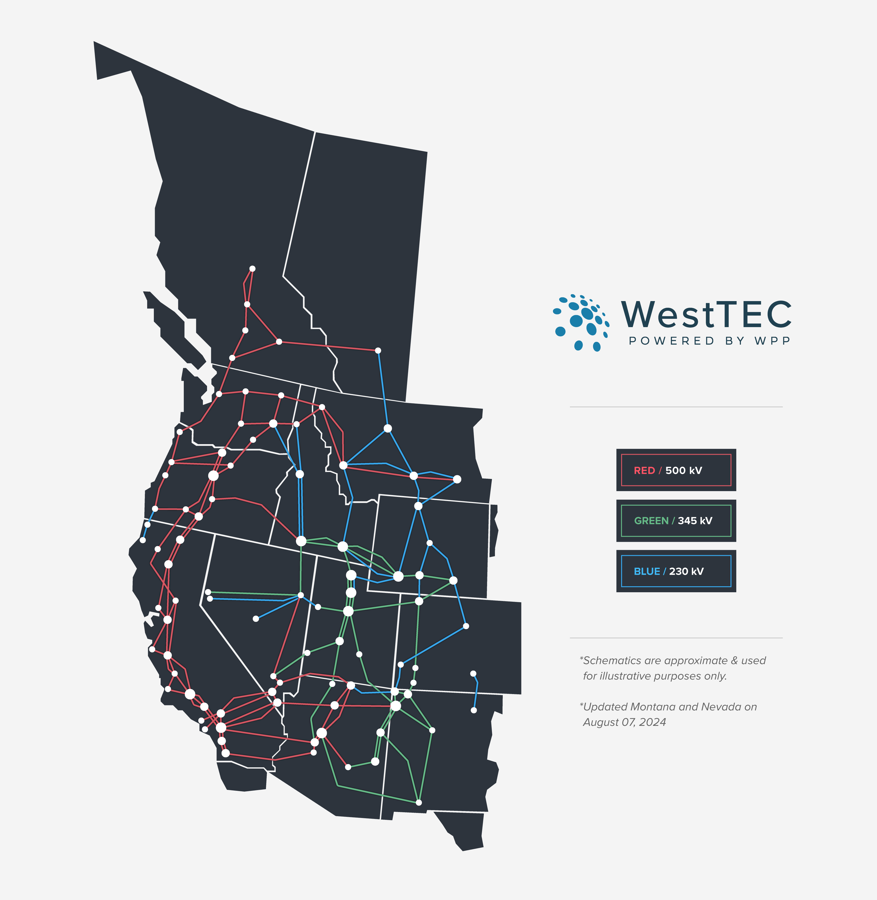
What is the Western Transmission Expansion Coalition?
“WestTEC”
Not a FERC process
West-wide 20-year transmission study (10-year look)
Industry-led with unprecedented regional partner inclusion
Goal is to produce an actionable transmission study
Notes:
Sarah

Slide 6
WestTEC Steering Committee Supporters
Amazon Energy
Arizona Public Service
Avista
Bonneville Power Administration
California ISO
Cascade Renewable Transmission
Clean Energy Buyers Association
Clean Grid Initiative
Colorado River Energy Distributors Association
Grant County PUD
Grid United
GridLiance
GridWorks/Liaison with States
Idaho Power Company
InterWest
Invenergy
LS Power
Northwest & Intermountain Power Producers Coalition
NorthWestern
NV Energy
Pacific Northwest Utilities Conference Committee
PacifiCorp
Pattern Energy
Portland General Electric
Powerex
Public Power Council
Public Service Company of New Mexico
Puget Sound Energy
Renewable Northwest
Salt River Project
Snohomish PUD
Southwest Power Pool
Tacoma Power
Warm Springs Power & Water Enterprises
Washington Department of Commerce
Western Area Power Administration
Western Electricity Coordinating Council
Western Interstate Energy Board
Xcel Energy

Slide 7
WestTEC Project Timeline
NEAR-TERM PLANNING HORIZON EFFORTS
LONG-TERM PLANNING EFFORTS
PROJECT DISTRIBUTION & REGIONAL PARTNER ENGAGEMENT
QUARTERLY PUBLIC ENGAGEMENT
2024
Q3
2024
Q4
2025
Q1
2025
Q2
2025
Q3
2025
Q4
2026
Q1
2026
Q2
2026
Q3
2026
Q4
2027
Q1
Oct 21: CREPC-TC Meeting
Mar 2025:
Steering Approves Scenarios
July 2026: Planning Scenarios Complete
May 21: All-Committee Meeting
Sept 2024: Final Study Plan
Feb:
Public Workshop
Aug 2025: Initial 10-year Horizon Report Complete
Sept 2026: Completion of 20-year Horizon Report and Final 10-year Horizon Report
May 27:
Public Workshop
We are here

Slide 8
New WestTEC Videos
We’re excited to announce the release of a new video series that provides WestTEC updates
The first video in the series offers an overview of the significant progress we’ve made to date, along with a look ahead at what’s next on the horizon
From there, join Keegan Moyer of Energy Strategies as he walks through each of the 10 key steps in the WestTEC process, offering detailed insights and expert context at every stage.
Navigate to the video using the link below. Once there you may choose to skip to different videos by using the drop-down arrow in the upper lefthand corner or the next video in the series will automatically play when the pervious video finishes.
https://vimeo.com/showcase/11708960
Notes:
This is an excellent opportunity to get up to speed on where we are, where we’re going, and what to expect in the upcoming phases of the project.
Thank you for your continued engagement as we move forward!

Slide 9
Study Execution Update
Notes:
20 minutes
Review of modeling platform and purpose
Technical Status Update
Approved 20-year Scenarios

Slide 10
Modeling Platform
Capacity Expansion Modeling
Powerflow Assessment
Congestion Assessment
What are the optimal 20-year generation plans & transmission overlays to meet load and policy needs?
What transmission expansion is needed to reliably move power from where it is generated to where it is consumed?
What transmission bottlenecks remain when the system is dispatched and operated for an entire year?
Value Proposition
Given the resulting transmission portfolios, what value do they provide, are they robust to certain assumptions, and can they withstand extreme weather events?
Notes:
Subject to multiple scenarios

Slide 11
Study Execution Update
Where we are at now…
10-year horizon (Reference Case): Developing, refining, and testing ~8 different models to identify near-term gaps in interregional transmission capacity
20-year horizon: Reference Case model results are effectively complete (see subsequent presentation by E3), with further work on busbar mapping and developing assumptions for scenarios.
Scenarios: Approved by Steering Committee at March meeting after extensive stakeholder engagement process
What to expect next…
After some delays, results from the assessment will be available in the next 2-3 months
  Report is generally on target to be issued in late summer ‘25
Results from busbar mapping analysis will be complete by early July for Reference Case and will feed into start of 20-year transmission analysis
Efforts focused on parametrization of scenario narratives
  Scenarios ready for transmission analysis in fall, 2025
Notes:
Last time we talked 10-year Reference Case was still under construction. We were compiling data. Shared transmission, load, and generation forecasts.
Last time we didn’t have a load forecast and we didn’t have model or load forecast.

Slide 12
Focus of Scenario Planning Effort
The scenario planning sub-team is facilitating the development of two alternative scenarios in the 20-year horizon
Scenarios consider variations in technology advancement, load growth, policy changes, among other factors
Scenario results will be used to identify persistent transmission needs across a range of future outcomes
Current System (Not Modeled)
10-year Reference Case
Reference
Flux
Today
2035
2045
Core
Notes:
- We don’t know exactly what transmission outcomes will be, but we can speculate
Saved scenario discussion for last because thinking of scenarios and their impacts to modeling requires a knowledge of the modeling

Slide 13
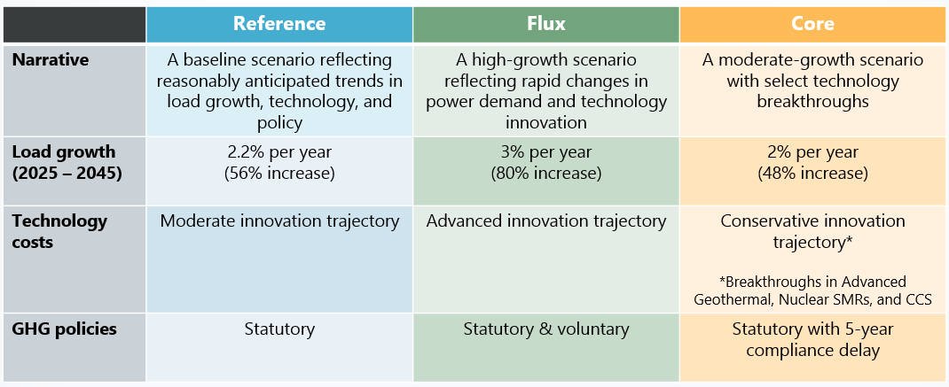
WestTEC 20-Year Scenarios
Notes:
Load Growth:
Last 20 years of WECC Load Growth: 0.2%
Energy Efficiency
Low-intensity compute demand
Services-based economy
Manufacturing offshoring
WECC 10-year Forecasts ~2.2%
Industrial Onshoring & Growth
High-intensity compute demand
All scenarios capture roughly reference or above (no low-load)
How high could electricity demand climb:
US peak growth post WWII: 6.5%
Industrializing Nations: 5-8%
Few examples of mature industrialized societies increasing demand above 3% after reaching a peak (Japan in 1980s and Korea and Germany in the 1990s)
There are instances from history when you overestimate load growth
Stranded assets: US Nuclear in the 1970s, Mercant Gas Plants in the early 2000s,
Load growth and load distribution
E3 has internal tools to update load profiles at a zonal level based on sector-specific growth assumptions
Load distribution in nodal model may have downstream issues
Resource technology assumptions
Resource costs differ between scenarios based on technology innovation & breakthrough assumptions
10-year resources as starting point, but possibly technical challenges handing downstream modeling effects
Policy
E3 has established and presented a methodology for representing/enforcing statutory, voluntary, and policy delay

Slide 14
Committees, States, and Tribes Update

Slide 15
20-year Horizon Reference Case Resource Portfolio and Capacity Expansion Modeling

Slide 16
WestTEC Public Webinar
E3 Capacity Expansion Results
May 27th, 2025
Arne Olson, Senior Partner
Jack Moore, Senior Director
Femi Sawyerr, Senior Managing Consultant

Slide 17
Content
Analytical Background and Context
Scenario Definition
Key Inputs
  Loads
  ELCCs for PRM Requirement
  Resource Costs
  Candidate Resource Availability
  Fuel Price Forecast
  Out-of-State/Remote Resource Modeling
  Transmission Expansion Costs
Total Capacity and Generation Results Summaries
Incremental Selected Capacity Results
Transmission Expansion Results

Slide 18
Analytical Background and Scenario Definition

Slide 19
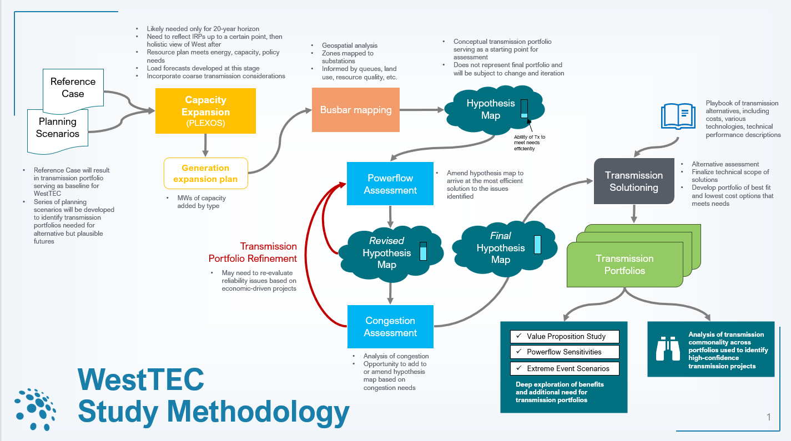
Capacity Expansion Role in WestTEC Project Workflow

Slide 20
Overview of Capacity Expansion Analysis
E3 is leading the capacity expansion analysis, utilizing the PLEXOS LT model to co-optimize intrazonal generation and storage resource portfolios, and inter-zonal transmission resources over the entire Western Interconnection.
The optimization will create portfolios that will incorporate the following in each of the modeled zones:
  Meet hourly load and reserve requirements
  Respect policy and voluntary goals
  Respect resource availability limits
  Result in the lowest Western-system-wide capital, dispatch, and penalty costs (if applicable)
The goal of the capacity expansion analysis is to create 20-year resource portfolios for each zone, which:
  incorporate generation, load, and transmission information from the 10-year study as base inputs
  utilize new load forecasts data that are being developed using a bottom-up approach
  utilize the latest generation, storage, and transmission resource costs and performance assumptions
  utilize scenario analysis to consider multiple potential future realities

Slide 21
20-Year Reference Scenario Definition
The 20-Year Reference Scenario optimizes resource and transmission expansion for 2035 and 2045
  The optimization samples 72 days per year with 24 hours per each sample day
This 20-Year Reference Scenario uses a load forecast that has a 2.2% CAGR between 2025 and 2045, building on the load forecast used in the 10-Year Reference Scenario
The clean energy standard (CES) adopted represents only the mandatory CES across all the jurisdictions in the WECC
  No voluntary utility or balancing area CES commitments are modeled
  In jurisdictions with no mandatory clean energy standards, all clean energy levels (as a percent share of load) that are achieved by 2035 (in the reference case) are assumed to be preserved through 2045
  CA, WA, and OR have carbon prices of $57/metric ton in 2035 and $106/metric ton in 2045 (nominal $)
Planning reserve margin (PRM) requirements are modeled at a regional level using the perfect capacity (PCAP) method, which can be met by (a) resources located within that region or (b) remote resources selected and specifically dedicate to serve load in that region; regional PRM targets are:
  CA – 15.6%
  Pacific Northwest – 5.6%
  Rockies – 10.8%
  Desert Southwest – 12.9%

Slide 22
Key Inputs

Slide 23
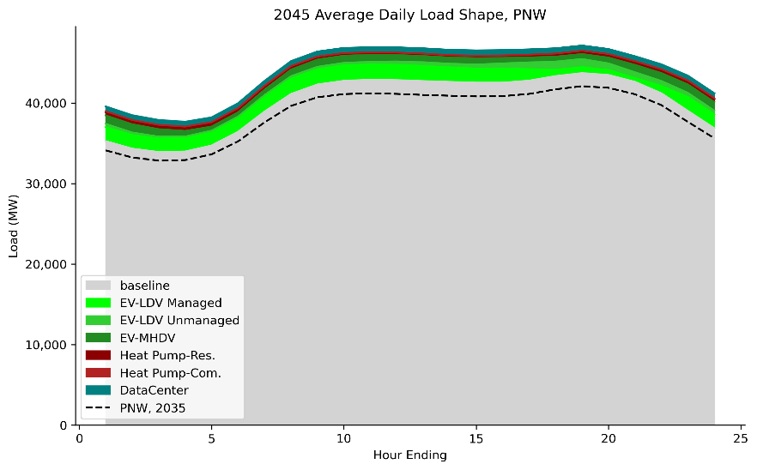
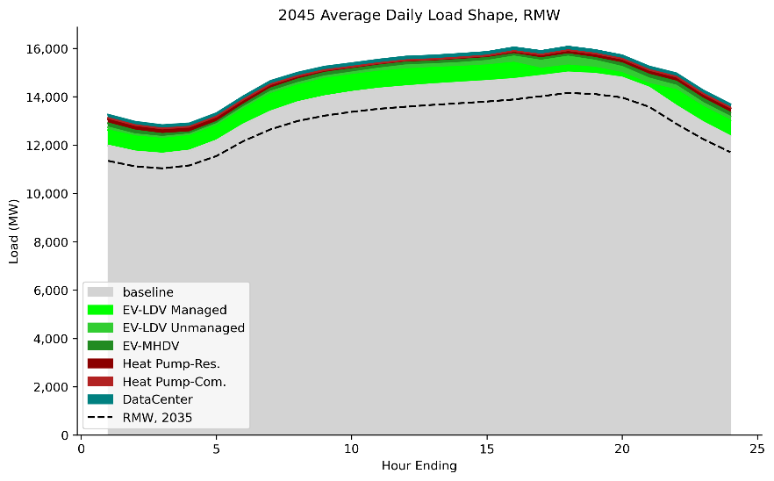
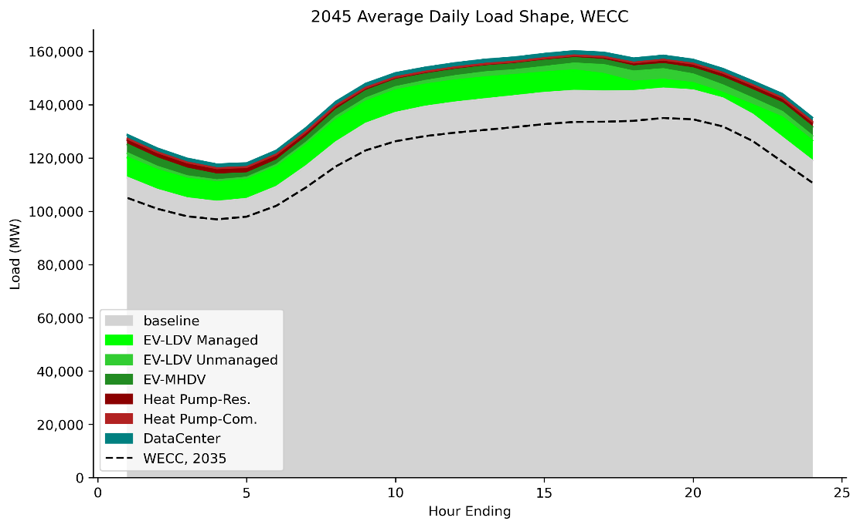
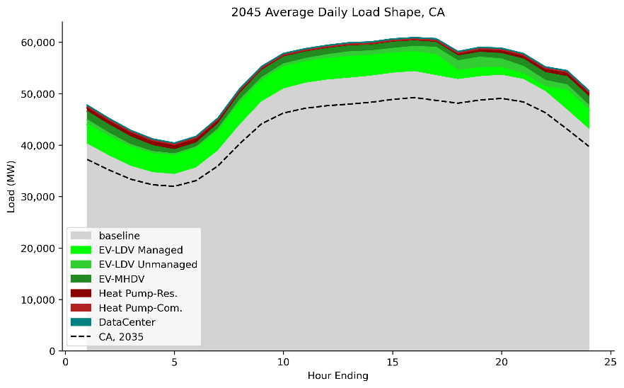
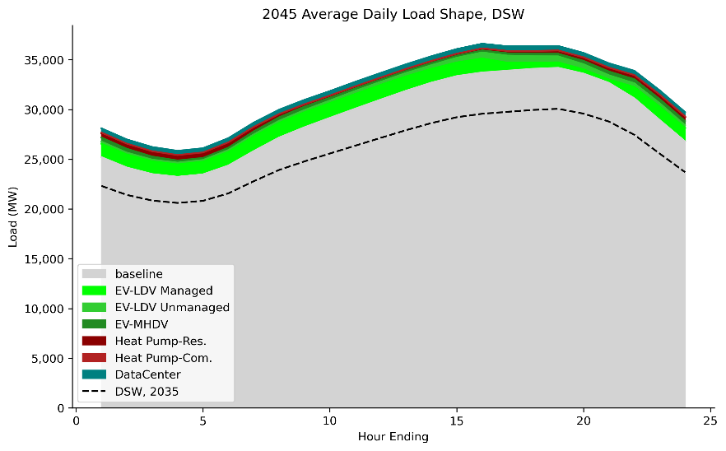
2045 Loads are stacked over the 10-Year Reference Scenario Loads
Note: E3 load components above shown for 2035-45 incremental additions
Electrification & data center load components in 2035 ((in previous slide) are included in grey ”baseline” area (broken out in next slide)

Slide 24
Marginal ELCC Curves by Region for Achieving PRM Requirement

Slide 25
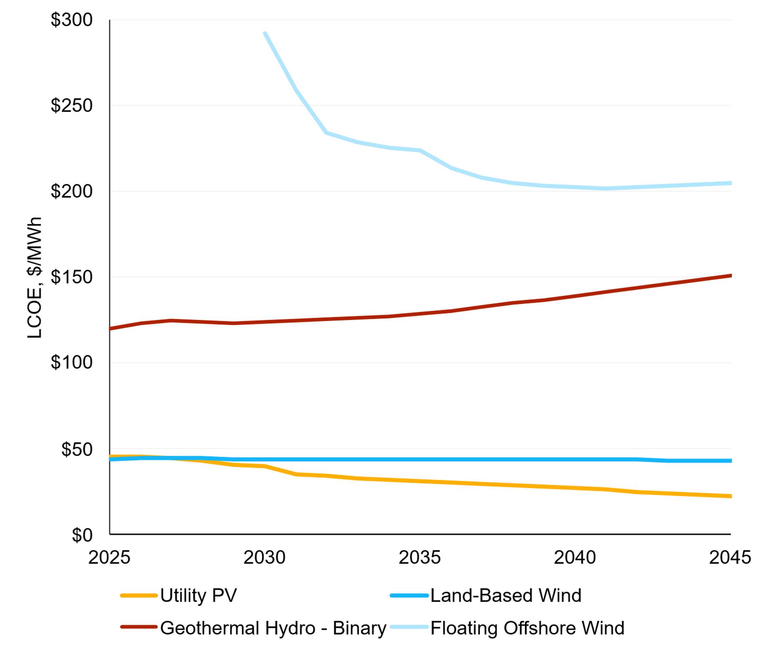
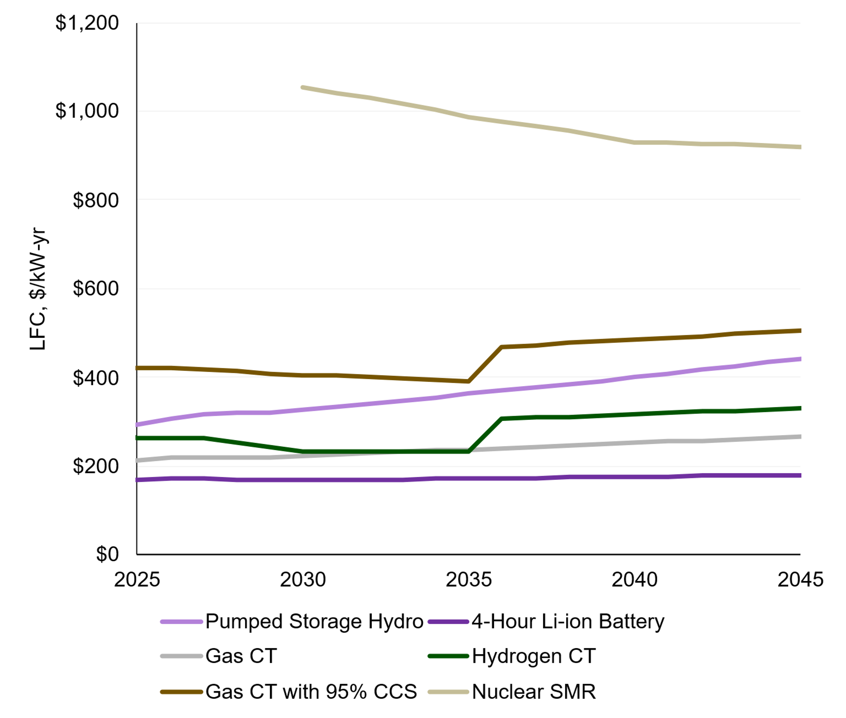
Nominal-Levelized Resource Costs (Average Across Regions)
Years correspond to Project COD (Vintage)
LCOE of Variable Renewable Resources
LFC of Firm Capacity Resources
Years correspond to project COD (vintage)

Slide 26
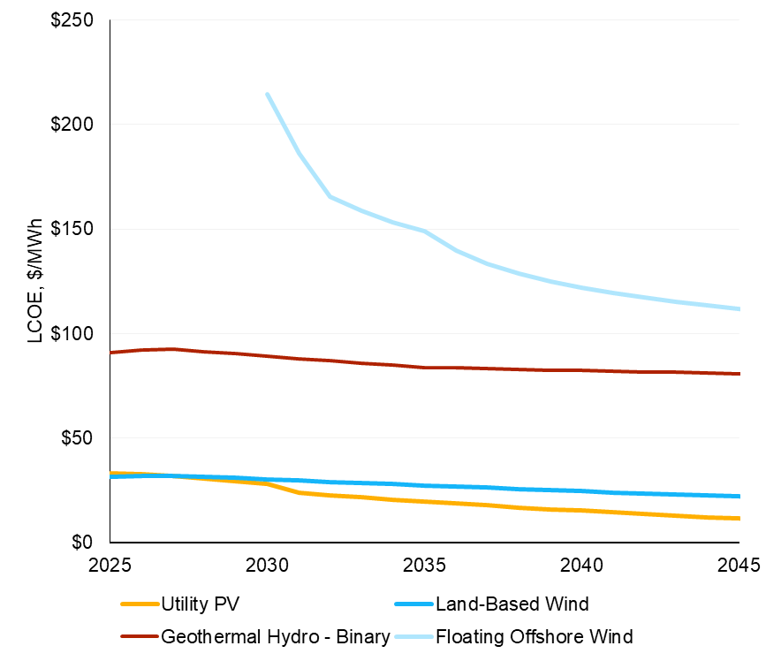
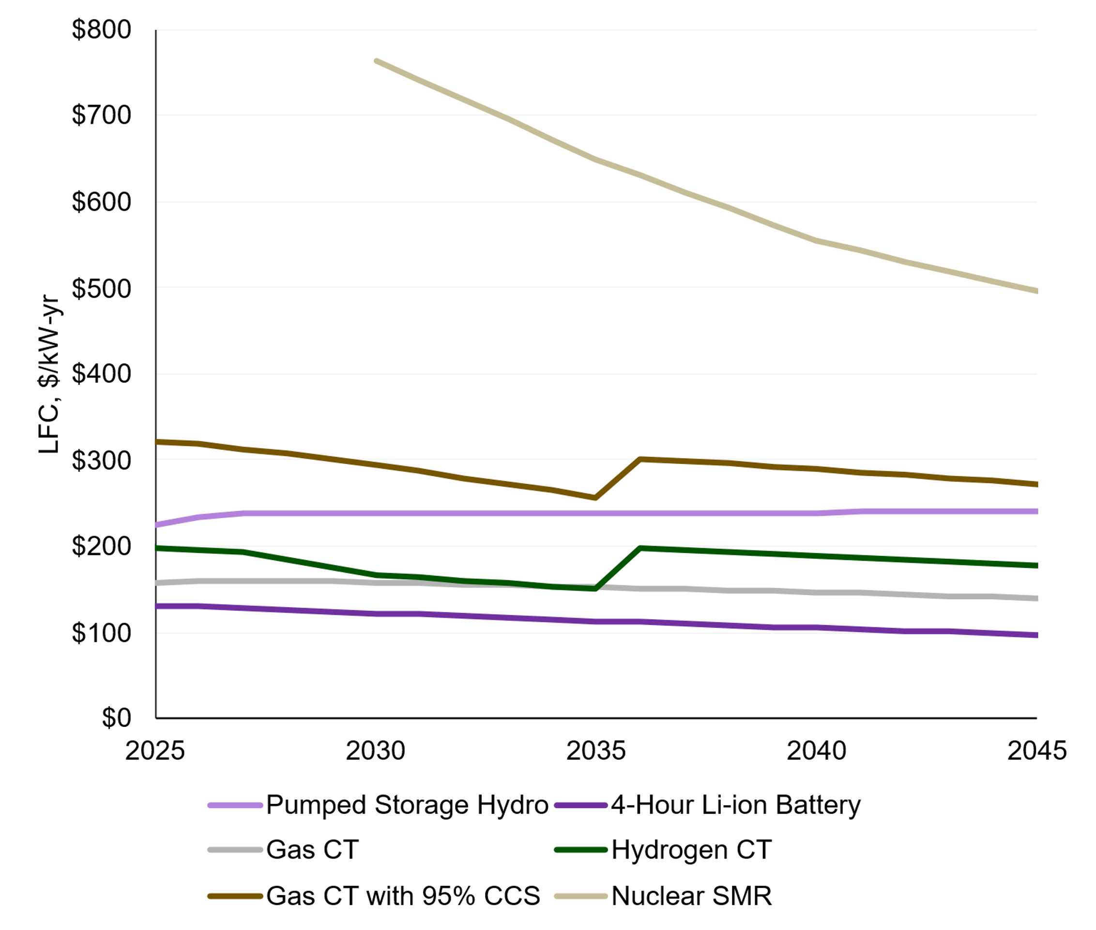
Real-Levelized Resource Costs (Average Across Regions), 2023$
Years correspond to Project COD (Vintage)
LCOE of Variable Renewable Resources
LFC of Firm Capacity Resources

Slide 27
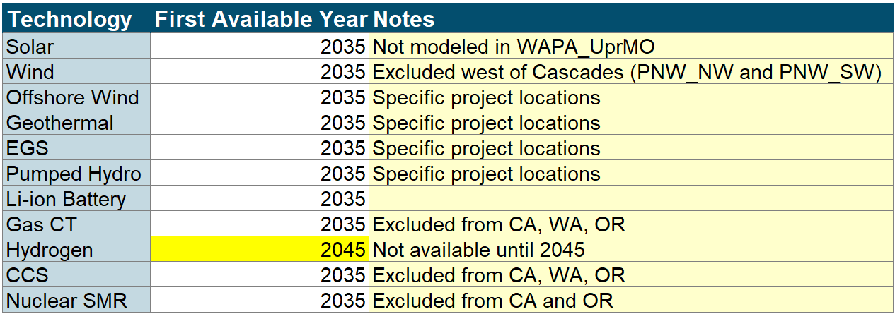
Candidate Resource Availability

Slide 28
Fuel Price Forecast
Summer Gas Price (Nominal $/MMBtu)
Winter Gas Price (Nominal $/MMBtu)
Core gas prices derived using a combination of forwards in the near-term and AEO fundamentals-based forecasts for the longer term
  Monthly SNL forwards for Henry Hub used through 2028
  Past 2028, Henry Hub forecast is trended to EIA forecasts by 2040
For all other hubs, monthly basis differentials are derived from SNL forwards in the near term
  3 years of monthly basis derived from forwards are averaged and assumed to hold constant through the forecast

Slide 29

Out-of-state/remote resource modeling
Out-of-state resources are placed in the load zone they are contracted to serve, rather than their physical remote zone, in the model. However, the transmission capacity required for the resource to flow from the remote zone to the load zone (which reduces headroom on the transmission line for other flows) is accounted for using the following constraint:
Subtract remote wind generator’s generation from the line rating
  Physical Line Flow Coefficient * 1 + remote wind Generator Generation Coefficient * 1 <= X
  This should not be applied to candidate remote gen that comes with dedicated new Tx
  Can be applied to multiple lines in a selected path between the load zone and the remote resource zone
Zone A
(load)
Load B
(remote resource)
Physical Line
Node From: Zone B (remote)
Node To: Zone A
Line Rating: [X, -Y]

Slide 30
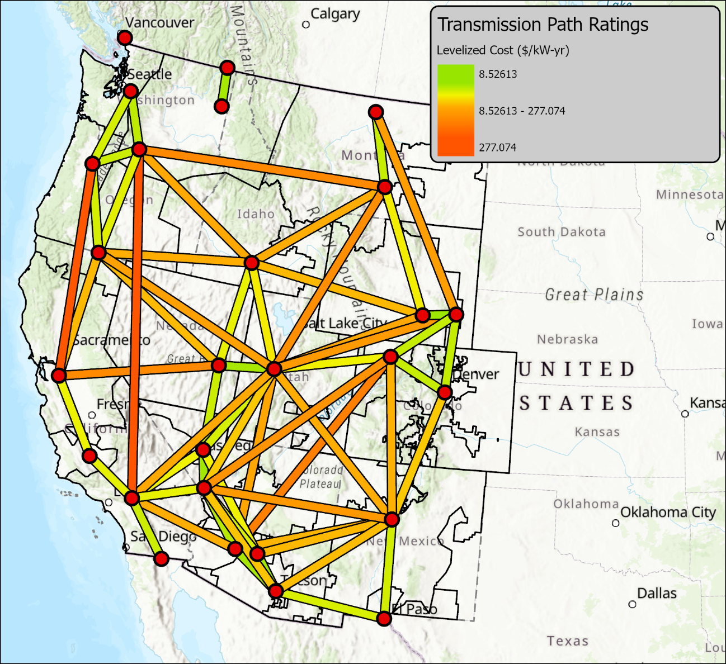
Transmission Expansion Costs Methodology
Identify a major high-voltage substation within each PLEXOS region to represent each region as a single node (presented previously)
Calculate the straight-line path between each region’s representative node
Calculate routing distance multipliers that consider both greenfield and existing ROW alternative paths¹
Using single-circuit compensated 500-kV per unit costs and transfer capabilities from MISO 2024 MTEP ² with the line distance, adjusted by routing multipliers (from 3), for overnight project costs in $/MW
Using the cost levelization parameters from the CPUC Draft I&A,³ to then calculate the LFC (2024 $/kW-yr) for each line using the overnight projects costs (from 4) and additional regional cost adjustments
Note: BCHA<>PNW_NW has been removed as a candidate option. Also, the representative locations for BCHA<>PNW_NE have been updated, with a corresponding change to LFC
Low Cost
Medium Cost
High Cost
¹ https://www.pnas.org/doi/10.1073/pnas.2204098120
² https://www.energy.gov/gdo/national-transmission-needs-study
³ https://www.caiso.com/documents/2024-20-year-transmission-outlook-jul-31-2024.pdf

Slide 31
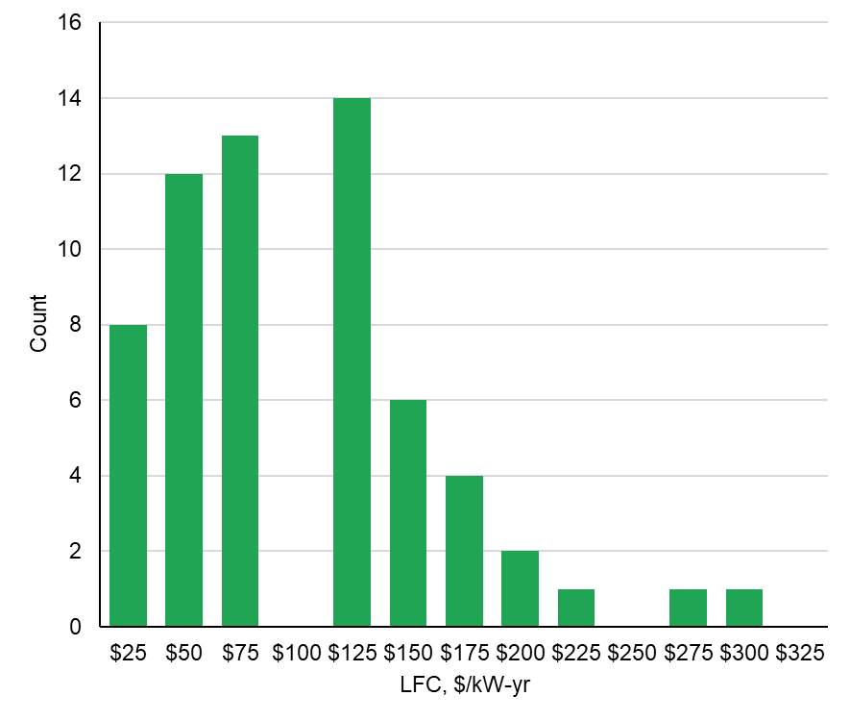
Transmission Cost Benchmarking
The generic transmission expansion costs we calculated were consistently in alignment with costs shown for certain in-development reference projects including:
  SWIP North
  New ONLine
  Transwest
  SunZia
Histogram of Candidate Transmission Costs
Current scenario candidate transmission options summarized by cost tier

Slide 32
Resource Expansion Results

Slide 33
Total Resource Capacity and Generation Summaries

Slide 34
2045 Total Resource Capacity
For simplicity, “Baseline Capacity” above includes the existing/planned resources remaining online in 2045 in the 10-yr Reference Portfolio. While the model does not optimize for economic retirement, it accounts for planned retirements of some baseline resources from 2035 to 2045, which can be found by comparing the next two slides.
Preliminary results. Subject to change.

Slide 35
2035 Total Resource Capacity (MW)
(10-yr Reference Portfolio + Selected Candidate Resources)
Note
  Generators built for a remote load center are included in the origination zone. E.g. NM wind for CA shows up in PNM.
  There are 4 regional capacity/PRM zones – CA, PNW, DSW, and Rockies. Resources built in any of the regions within the same capacity zone can contribute equally to meeting that region’s PRM.
Total builds in 2035 largely reflect portfolios identified in the 10-Year Reference Scenario with some additional wind resources added primarily based on economics
  Model runs intertemporally so 2035 builds include consideration & anticipation of 2045 needs and value
Preliminary results. Subject to change.

Slide 36
2045 Total Resource Capacity (MW)
(10-yr Reference Portfolio + Selected Candidate Resources)
Note
  Generators built for a remote load center are included in the origination zone. E.g. NM wind for CA shows up in PNM.
  There are 4 regional capacity/PRM zones – CA, PNW, DSW, and Rockies. Resources built in any of the regions within the same capacity zone can contribute to the regional PRM.
Total builds in 2045 represent significant resource additions relative to 2035, with a diverse set of generation and capacity resources
Preliminary results. Subject to change.

Slide 37
Capacity Requirements and Resource Capacity Values (MW)

Slide 38
Capacity Requirements and Resource Capacity Values (MW)

Slide 39
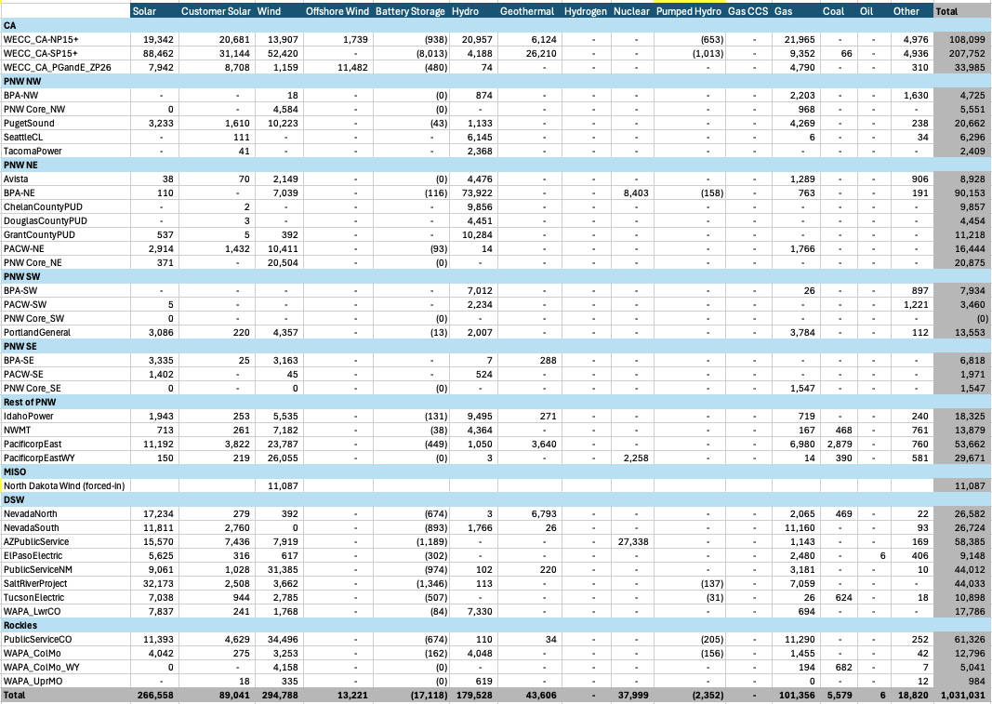
2035 Total Resource Generation (GWh)
(10-yr Reference Portfolio + Selected Candidate Resources)
Note
  For this energy generation summary, the generators built for a remote load center are included in the load delivery zone. E.g. NM wind for CA shows up in CA.
The significant portion of generation is from renewable resources
  Fossil generation accounts for about 15% of total generation

Slide 40
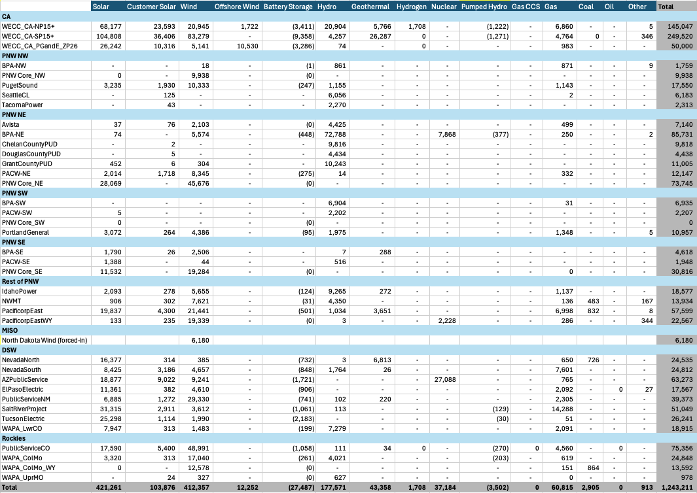
2045 Total Resource Generation (GWh)
(10-yr Reference Portfolio + Selected Candidate Resources)
Note
  For this energy generation summary, the generators built for a remote load center are included in the load delivery zone. E.g. NM wind for CA shows up in CA.
Even more of the total generation is from renewable resources
  Fossil generation now accounts for less than 10% of the total generation

Slide 41
Incremental Selected Capacity (Beyond 10-Year Reference Portfolio)

Slide 42
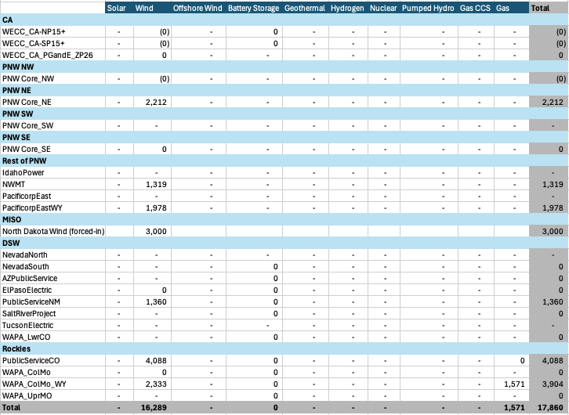
2035 Selected Candidate Resource Capacity (MW)
(Incremental to 10-yr Reference Portfolio)
The model choses to primarily add wind beyond the resources in the 10-year Reference portfolio
  Note: Generators built for a remote load center are included in the origination zone. E.g. NM wind for CA shows up in PNM.
  Model runs intertemporally so 2035 builds include consideration & anticipation of 2045 needs and value
The optimization also adds some capacity resources in the Rockies, which is capacity short
  There are 4 regional capacity/PRM zones – CA, PNW, DSW, and Rockies. Resources built in any of the regions within the same capacity zone can contribute to the regional PRM.
  Busbar mapping and powerflow analyses will determine the final placement of gas and hydrogen capacity resources within regions
Preliminary results. Subject to change.

Slide 43
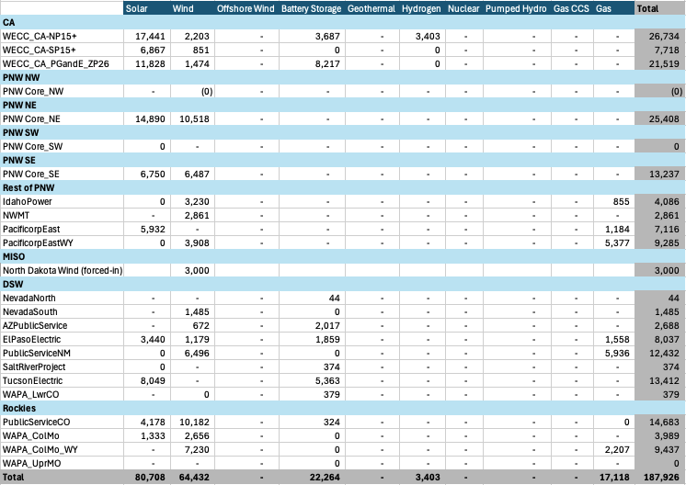
2045 Selected Candidate Resource Capacity (MW)
(Incremental to 10-yr Reference Portfolio)
Solar and wind comprise the bulk of new resource additions
  Note: Generators built for a remote load center are included in the origination zone. E.g. NM wind for CA shows up in PNM.
In most regions, new gas is the primary capacity resource added to meet PRM, along with some reliance on battery storage
  Hydrogen is added as new capacity in California likely because new gas build is not allowed for 2045
  There are 4 regional capacity/PRM zones – CA, PNW, DSW, and Rockies. Resources built in any of the regions within the same capacity zone can contribute to the regional PRM.
  Busbar mapping and powerflow analyses will determine the final placement of gas and hydrogen capacity resources within regions
Preliminary results. Subject to change.

Slide 44
2045 Selected Candidate Resource Capacity
(Incremental to 10-yr Reference Portfolio)
A significant amount of remote wind is developed through 2045 for delivery to load zones mostly in CA and the PNW
This is largely driven by the availability of existing and planned transmission connected to the regions with high capacity factor wind
  This remote wind complements the solar and storage and local wind developed in these zones
Updated Portfolio
Preliminary results. Subject to change.

Slide 45
Transmission Expansion Results

Slide 46
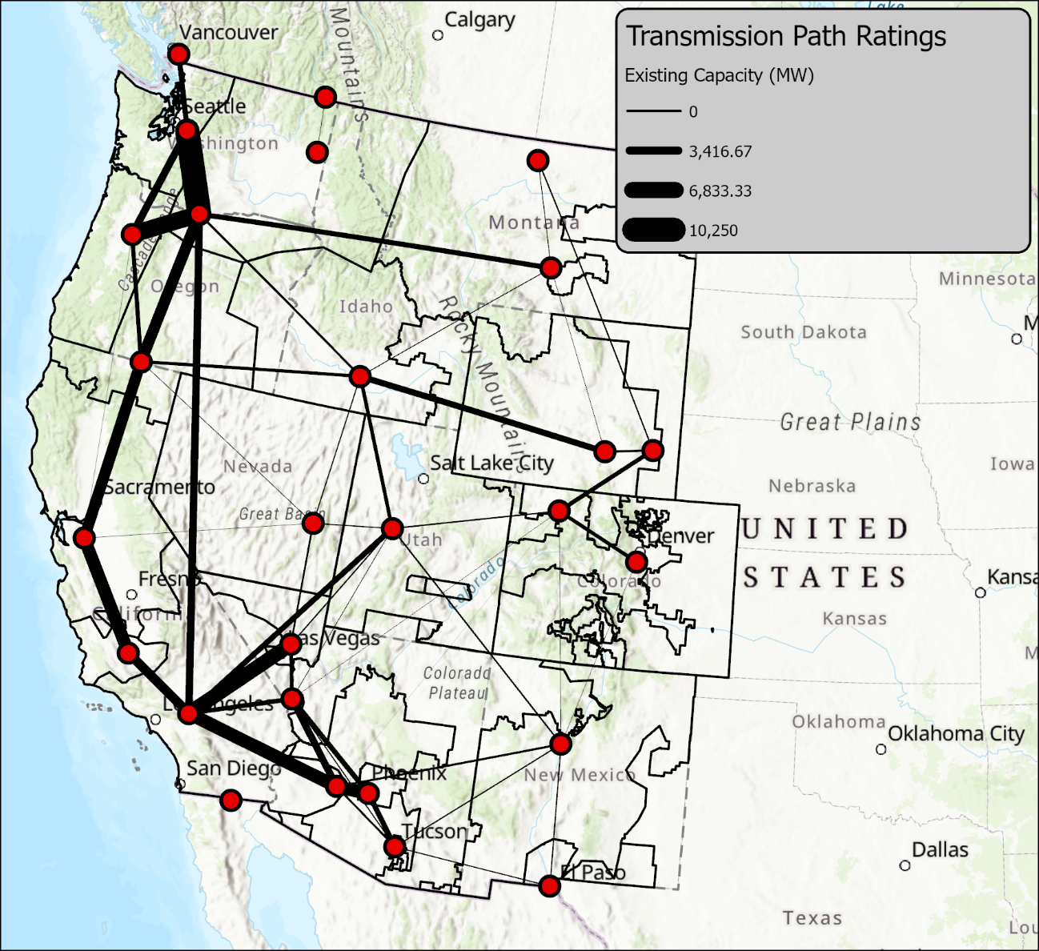
Existing Transmission Path Ratings
The existing transmission path ratings represent present-day limits on interzonal power flow, excluding planned or in-development interregional transmission projects
Existing transmission path ratings were primarily taken by reviewing the WECC Path Ratings
For other interties, the maximum historical BA-BA interchange over recent historical years (2018-2024) is used to infer a path rating

Slide 47
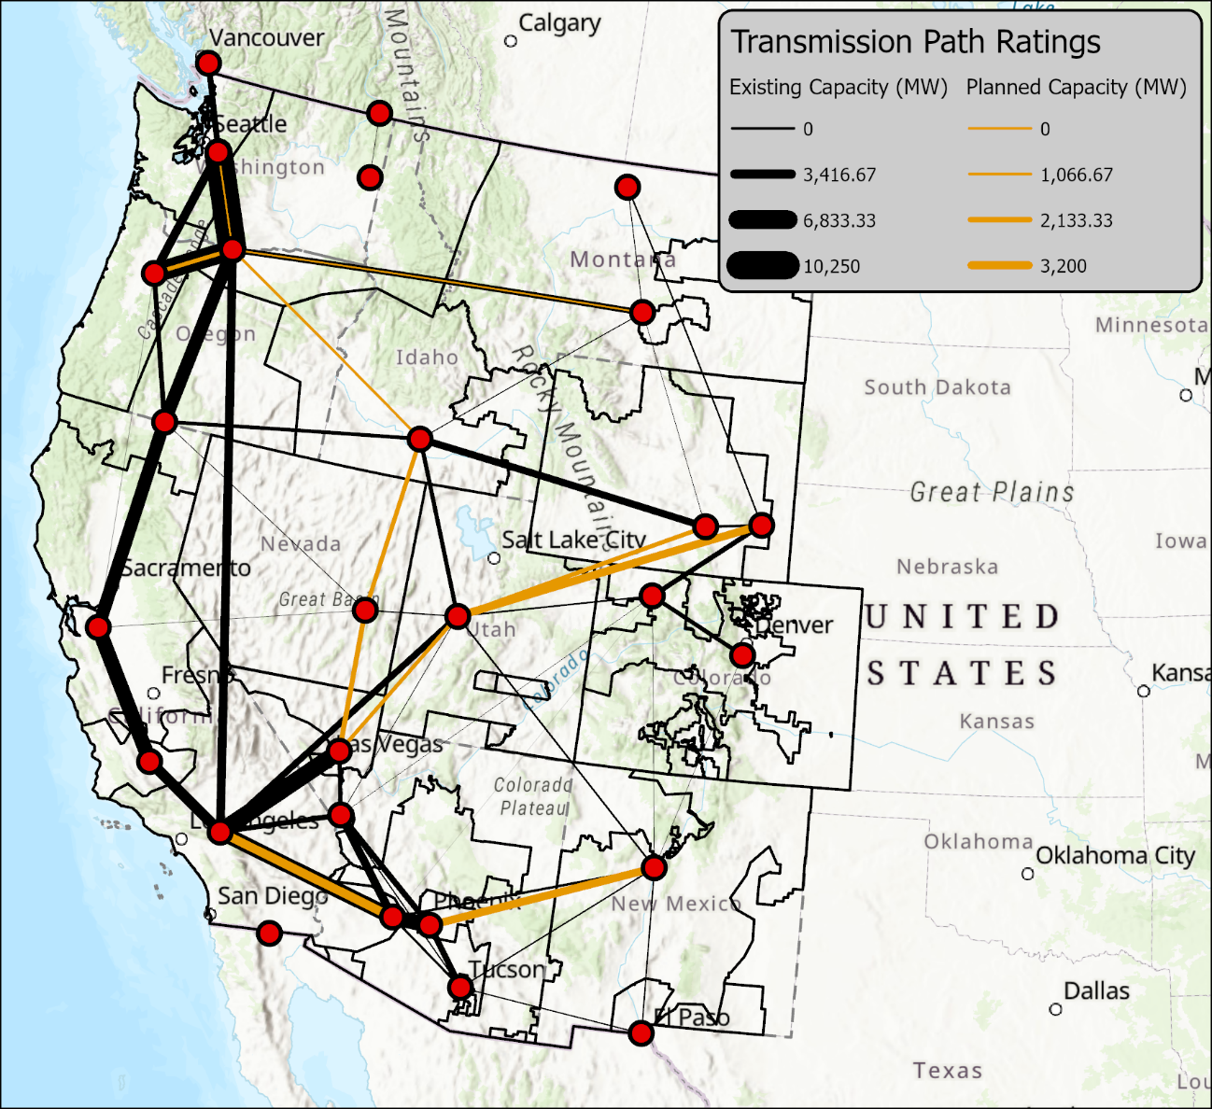
Planned and In-Development Transmission Projects
Major planned and in-development transmission projects are incremental to the existing transmission path ratings
Major interregional transmission projects are assumed to be online by 2035 and add to the total path ratings:
  BPA Evolving Grid 1.0
  B2H
  Gateway
  TransWest Express
  SWIP North
  Greenlink
  ONLine Uprate
  SunZia
  Ten West Link
BPA Evolving Grid 1.0
+650 MW
BPA Evolving Grid 1.0
+1500 MW
B2H
1400/1000 MW
SWIP North
1700 MW
TransWest DC
3000 MW
ONLine Uprate
1200 MW
Gateway South
1700 MW
Greenlink
725 MW N-S
TransWest AC
1500 MW
Ten West Link
3200 MW
SunZia
3000 MW
Preliminary results. Subject to change.

Slide 48
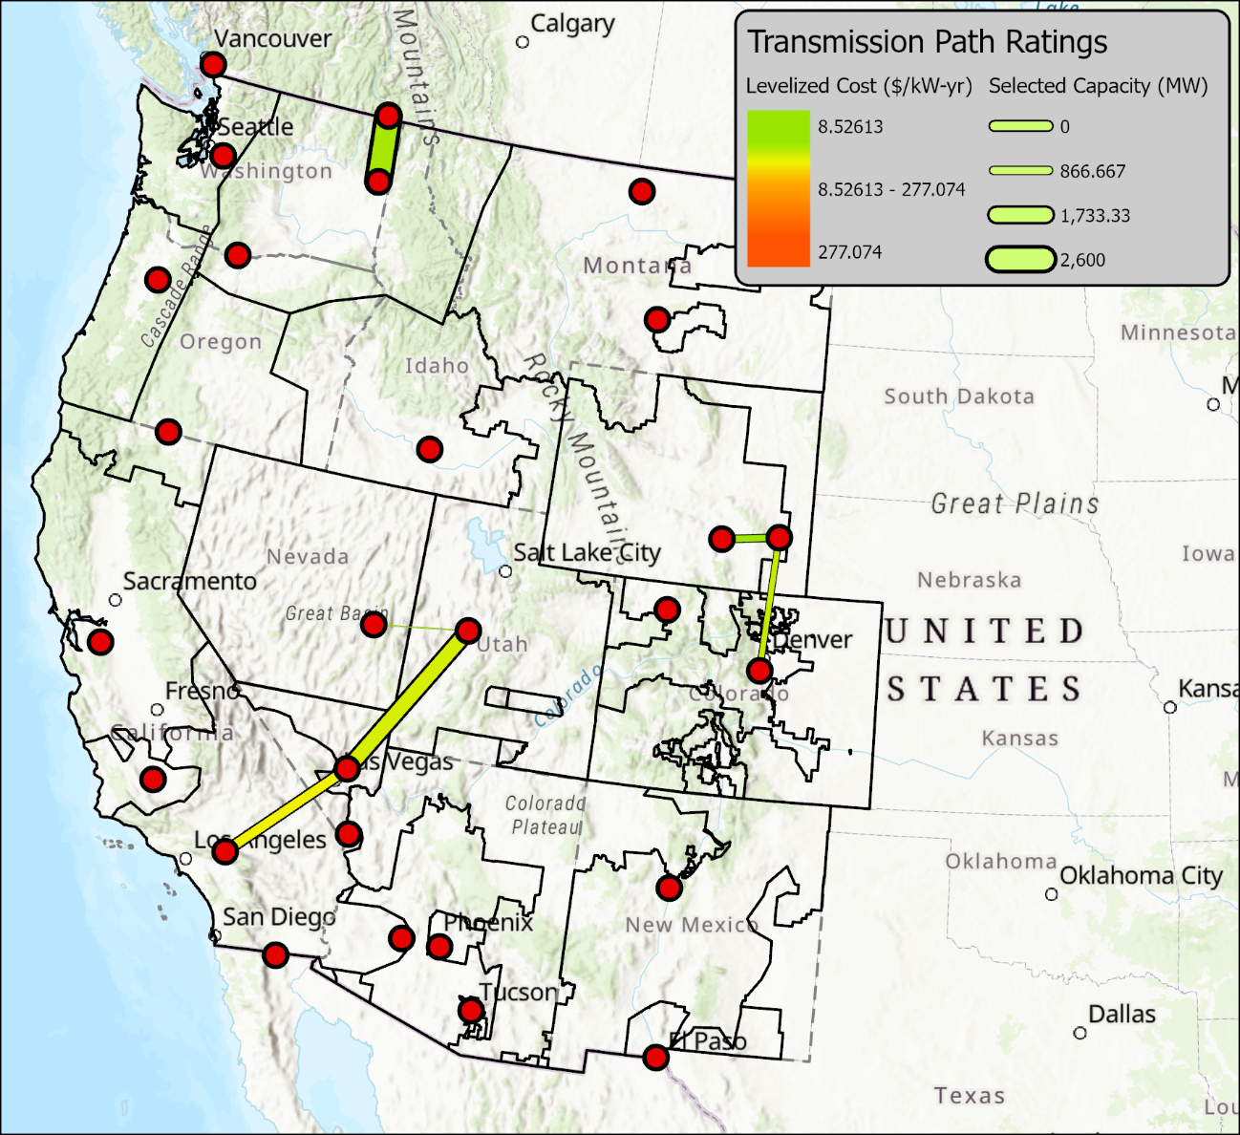
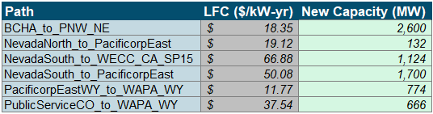
Selected Transmission Lines, 2045
Note: Change in Scale
Less wind is selected in this portfolio relative to previous portfolio results shared with the WATT, which has reduced the need for interregional transmission
  This is due to the cost of wind being higher than operating costs of existing natural gas generators
Lines are selected to deliver WY wind to loads in Colorado and Nevada/California
The BCHA <> PNW_NE upgrade cost was lowered to reflect a shorter path length; 2.6 GW of new capacity is now selected
Low Cost
Medium Cost
High Cost
Preliminary results. Subject to change.

Slide 49
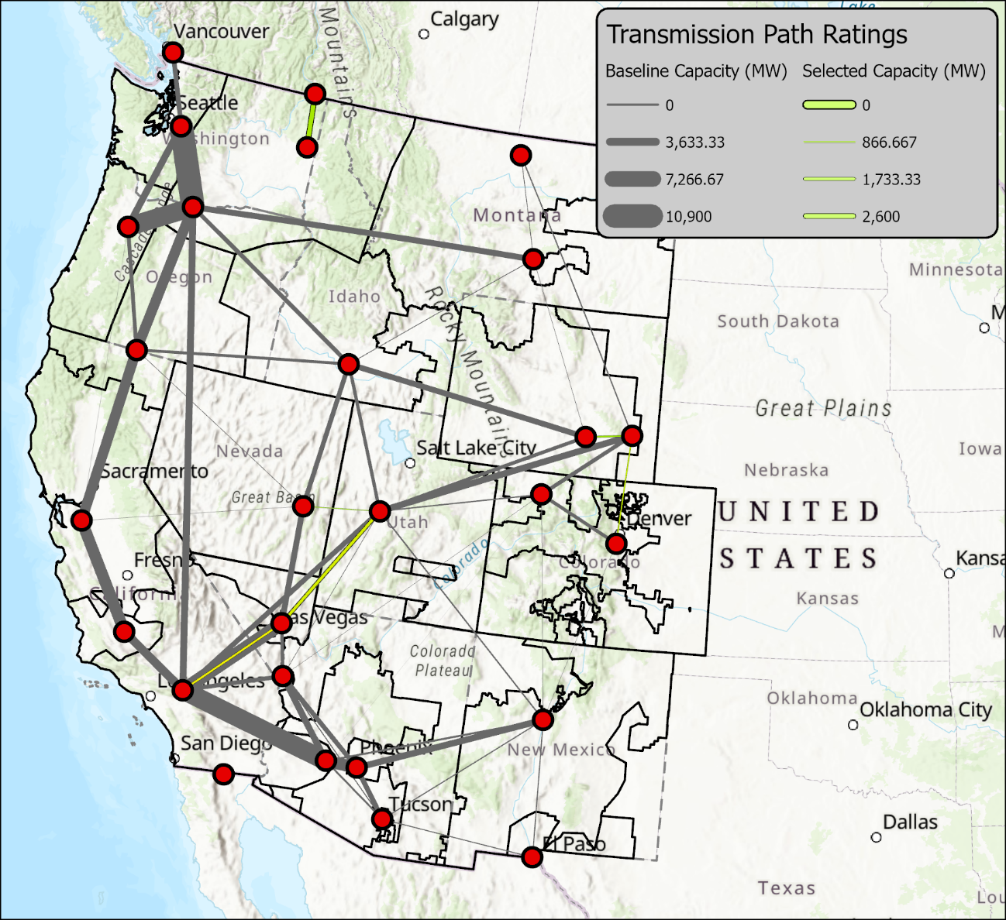
Selected Transmission Lines, 2045
Including Baseline (Existing and Planned) Transmission Paths
Note: Change in Scale
The amount of selected expansion is small compared to the significant amount of existing and planned transmission
  That is why the yellow lines seem significantly thinner than the grey lines because of the difference in quantity
  The chart uses a different scale than the chart on the previous slide.
Preliminary results. Subject to change.

Slide 50
If you have any questions or feedback, please feel free contact us.
Arne Olson, arne@ethree.com
Jack Moore, jack@ethree.com
Femi Sawyerr, femi@ethree.com

Slide 51
10-Year Horizon Technical Update

Slide 52
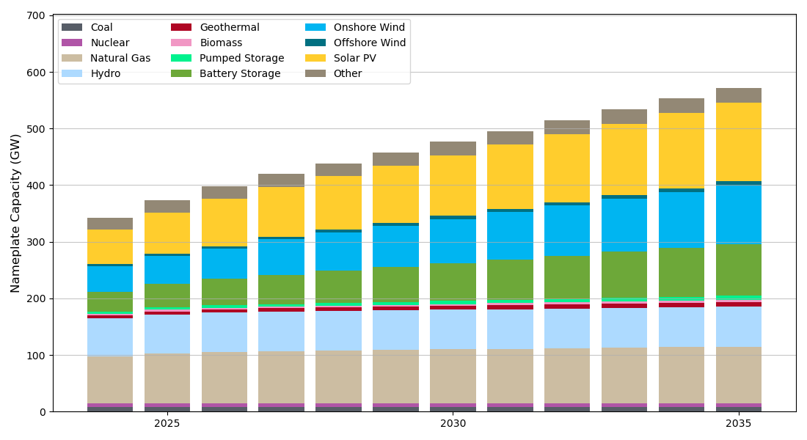
10-year Horizon Assessment: Scope and Purpose
WestTEC features 10-year and 20-year study horizons focused on evaluating transmission requirements in the years 2035 and 2045
  These materials address the 2035 Reference Case (“current trend”) modeling platform
The 10-year assessment:
  Is limited to a single Reference Case scenario
  Focuses on identifying near-term gaps in interregional transmission infrastructure
  May identify transmission expansion opportunities not otherwise addressed in regional or local planning processes
  Will focus transmission solutioning in response to needs on only those options that could be realistically developed in the study horizon
  Will be less focused on large portfolios of upgrades and will seek to identify targeted and discrete transmission upgrades
WECC-system Capacity by Type (GW)
Notes:
10-year case is really about the foundation of the 20-year modeling
Need a reputable starting point.
Before we look out, we need reliability assurance in the near-term.
Prior updates have covered demand

Slide 53


Likely needed only for 20-year horizon
Need to reflect IRPs up to a certain point, then holistic view of West after
Resource plan meets energy, capacity, policy needs
Load forecasts developed at this stage
Incorporate coarse transmission considerations
Geospatial analysis
Zones mapped to substations
Informed by queues, land use, resource quality, etc.
Conceptual transmission portfolio serving as a starting point for assessment
Does not represent final portfolio and will be subject to change and iteration
Reference Case
Capacity Expansion
(PLEXOS)
Busbar mapping
Hypothesis Map
Playbook of transmission alternatives, including costs, various technologies, technical performance descriptions
Planning
Scenarios
Ability of Tx to meet needs efficiently
Reference Case will result in transmission portfolio serving as baseline for WestTEC
Series of planning scenarios will be developed to identify transmission portfolios needed for alternative but plausible futures
Generation expansion plan
Powerflow Assessment
Transmission Solutioning
Alternative assessment
Finalize technical scope of solutions
Develop portfolio of best fit and lowest cost options that meets needs
Amend hypothesis map to arrive at the most efficient solution to the issues identified
MWs of capacity added by type
Revised Hypothesis Map
Final Hypothesis Map
Transmission
Portfolios
Transmission Portfolio Refinement
Transmission
Portfolios
Transmission
Portfolios
May need to re-evaluate reliability issues based on economic-driven projects
10-year assessment is here
Congestion Assessment
Value Proposition Study
Analysis of transmission commonality across portfolios used to identify high-confidence transmission projects
Analysis of congestion
Opportunity to add to or amend hypothesis map based on congestion needs
Powerflow Sensitivities
WestTEC
Study Methodology
Extreme Event Scenarios
Deep exploration of benefits and additional need for transmission portfolios

Slide 54
10-year Horizon Assessment: Recent progress
10-year Horizon Modeling Update
Developed two of the four draft models for the System Reliability Assessment and issued models for review via WECC portal (aka “Screening #1”)
  Continuing to receive and incorporate feedback – have heard from 15-20 organizations
  New dispatch for future releases
Have shared draft Congestion Assessment results at WATT and plan to release draft 2035 GridView model with Screening #2 package
  Draft results from economic model used to inform SRA
  Applicable feedback in SRA being incorporated to economic model
Working with WATT to develop up to three Area Deliverability Assessment cases representing stressed system conditions across the interconnection
System Reliability Assessment
Summer Peak
Winter Peak
Not started
Under construction
Draft/review
Complete
Max Wind
Max Solar
Area Deliverability Assessment
Economic
TBD
TBD
Reference Case
TBD

Slide 55
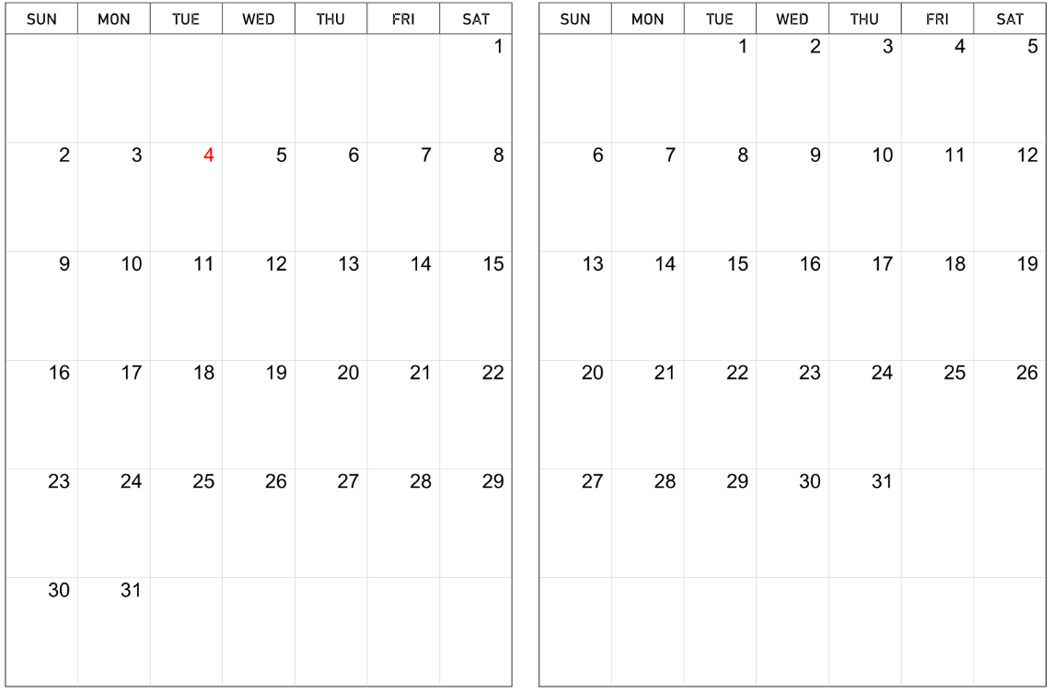
System Reliability Assessment Dispatch Methodology
Generation dispatch and area interchange calculated from the 10-year reference production cost model at time of peak load for applicable season.
1
Identify days with highest load during applicable season
Calculate expected wind, solar, and BESS dispatch for each area (BA) based on output at time of system peak
2
2
1
4
5
3
XX% of Pmax
Hour of Day
Straw proposal assumes 5 days during August and July
With area-level interchange, renewable, and storage levels established, remaining thermal and hydro units in area can be dispatched
3
Use similar approach to establish area-to-area interchange levels for system condition
4
Load
Interchange
Interchange
Load
MWs of interchange
Area A to Area B interchange during system peak (single hour)
Area A
Area B

Slide 56
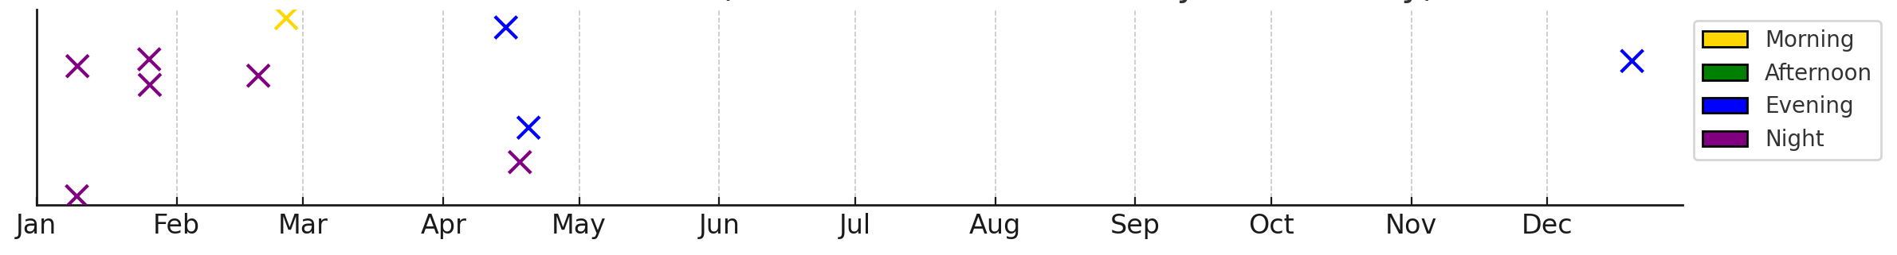
Identifying High Renewable Hours for SRA: High Wind Condition
Top 10 Wind Hours Identified
High WECC wind events generally occur during spring evenings and nights. WECC BA average load factor is around 55%, reflecting low load conditions.
Do we have sufficient interregional transmission to reliably transfer ~57 GW of wind to loads?

Slide 57
WECC Path Congestion Scatter Plot (Congested Hours >= 100)
*Preliminary results – subject to change

Slide 58


Action Items & Next Steps
20-Year Resource Portfolio Busbar Mapped to Nodal System by early July
Initial 10-year horizon report to be completed by end of August

Slide 59
Discussion/Q&A​
​
Admin-WTEC@westernpowerpool.org
Notes:
Sarah

Slide 60
Wrap-Up
This webinar has been recorded and will be posted along with this presentation to the WestTEC website in the coming days at WPP
Please check out the new and informative WestTEC video series at https://vimeo.com/showcase/11708960
Look for the next Public Webinar to be scheduled in late summer
Thank you for your support and participation!

